Slide 1


Quasars Probing Quasars:
Thinking Outside the Grid
Joseph F. Hennawi
MPIA
Heidelberg
November 2, 2010
Notes:
Today I’m going to tell you how to find extremely rare pairs of quasars with small angular separation on the sky. I will show how these unique sightlines can be used with the help of absorption line techniques to study the properties of diffuse gas in the outskirts of massive proto-galaxies. A central tenet of my talk will be that the hydrodynamics of diffuse gas can be easily simulated and is indeed resolved by current simulation grids. Hence the title:

Slide 2

Credits
Jason Xavier Prochaska
(UCSC)

Slide 3
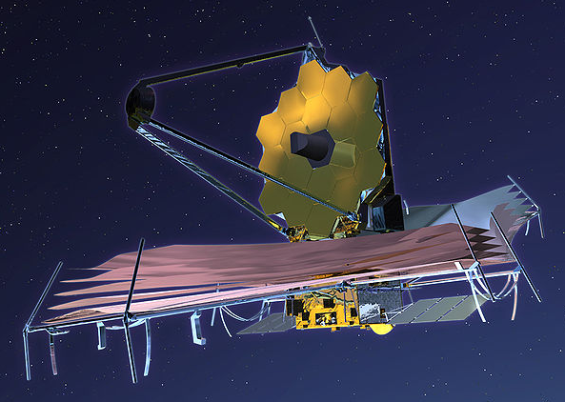
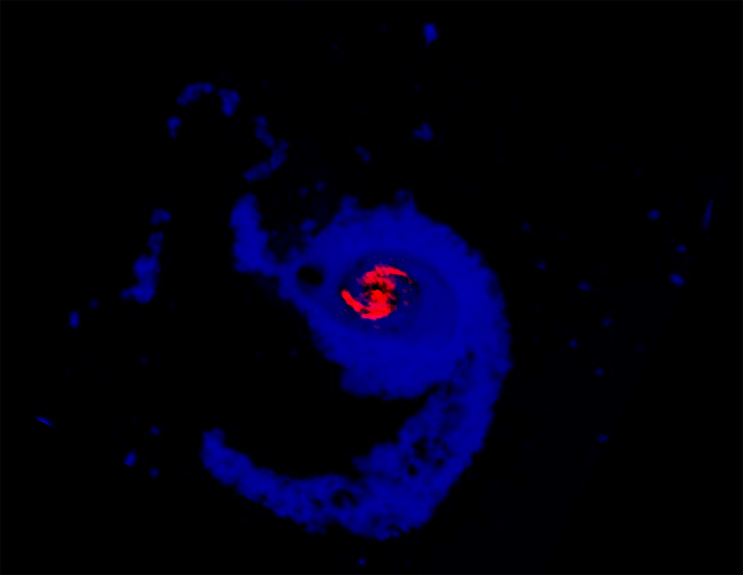
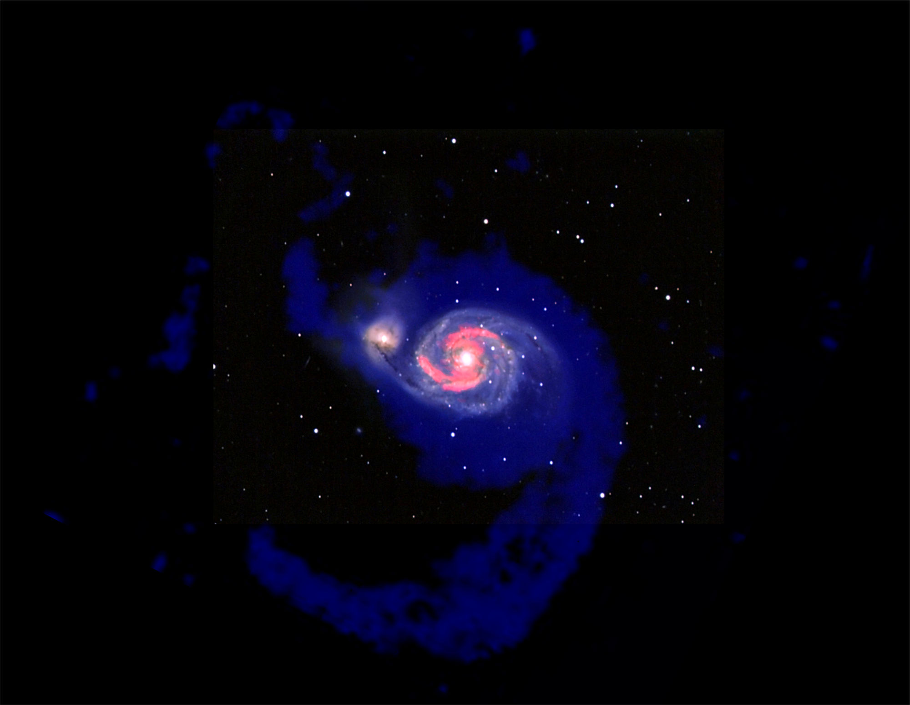
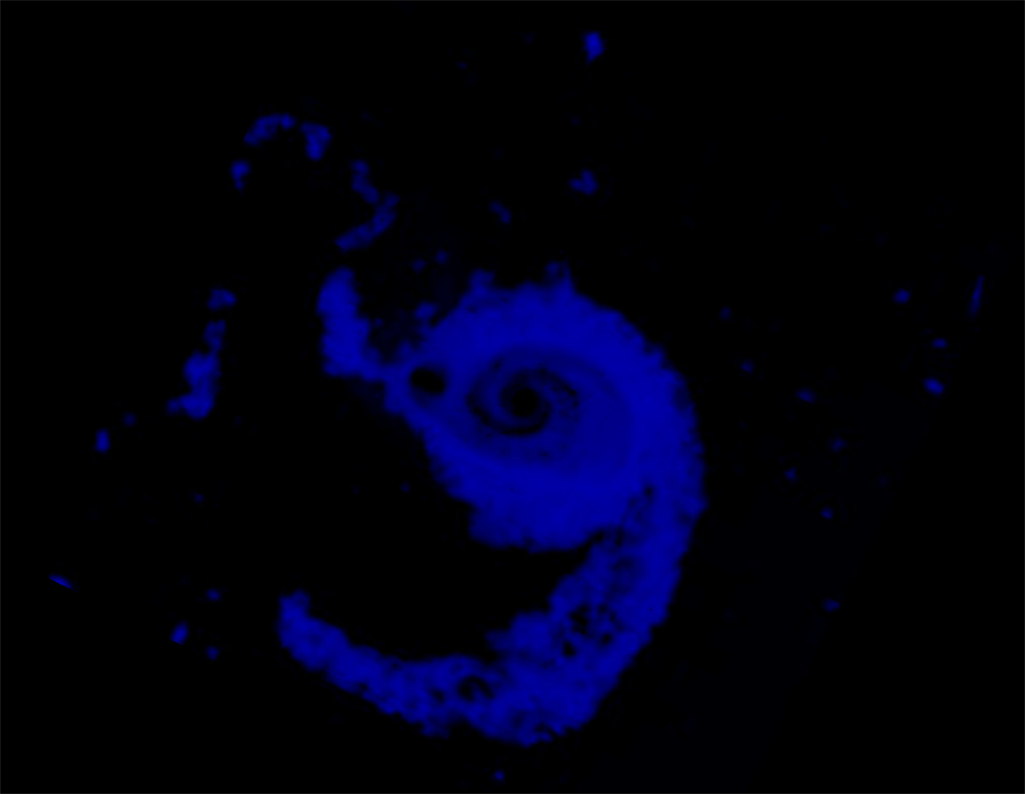
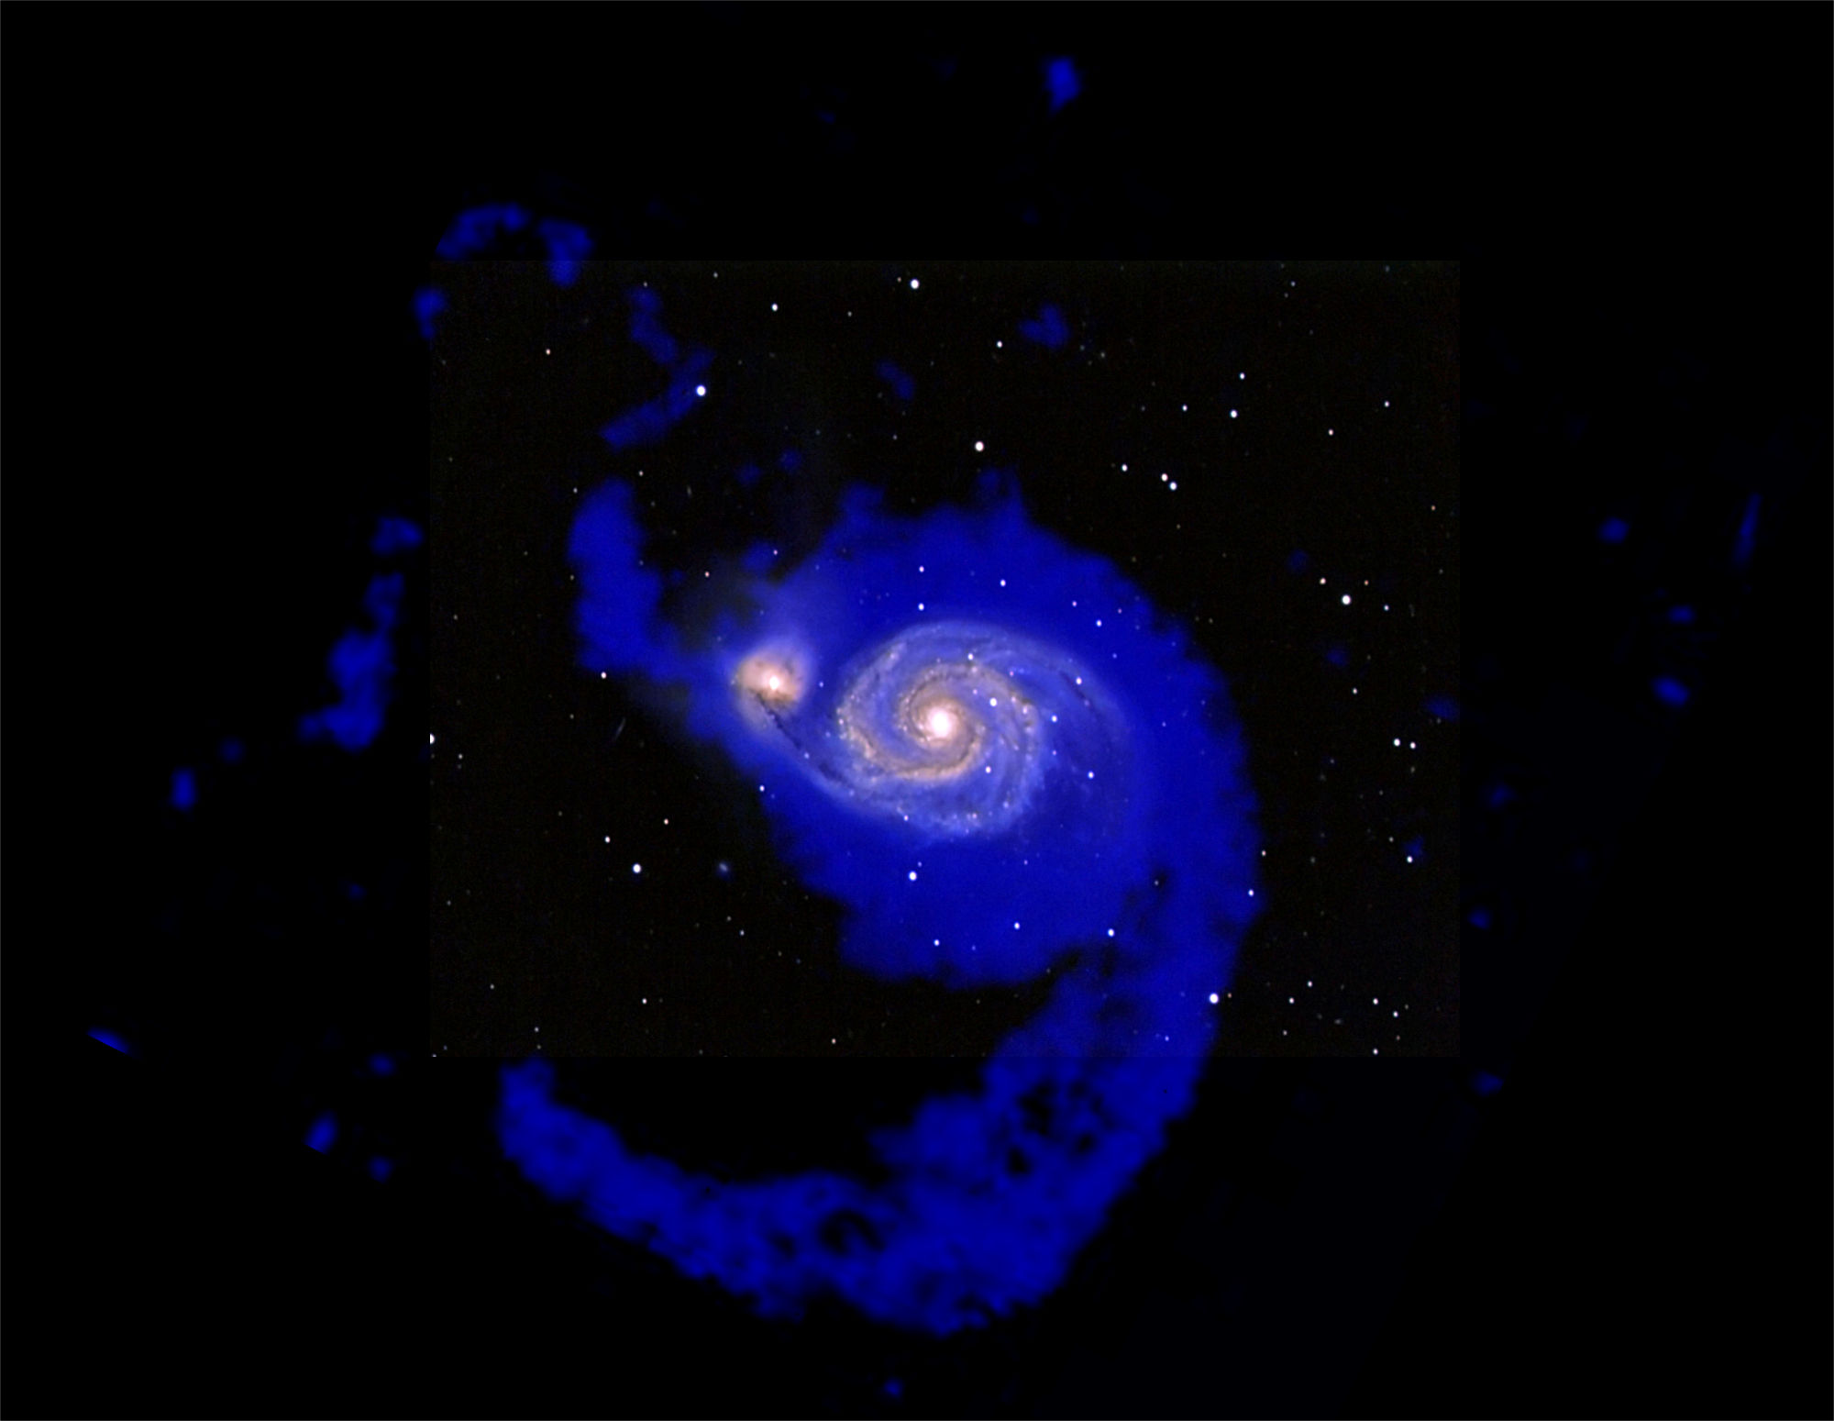
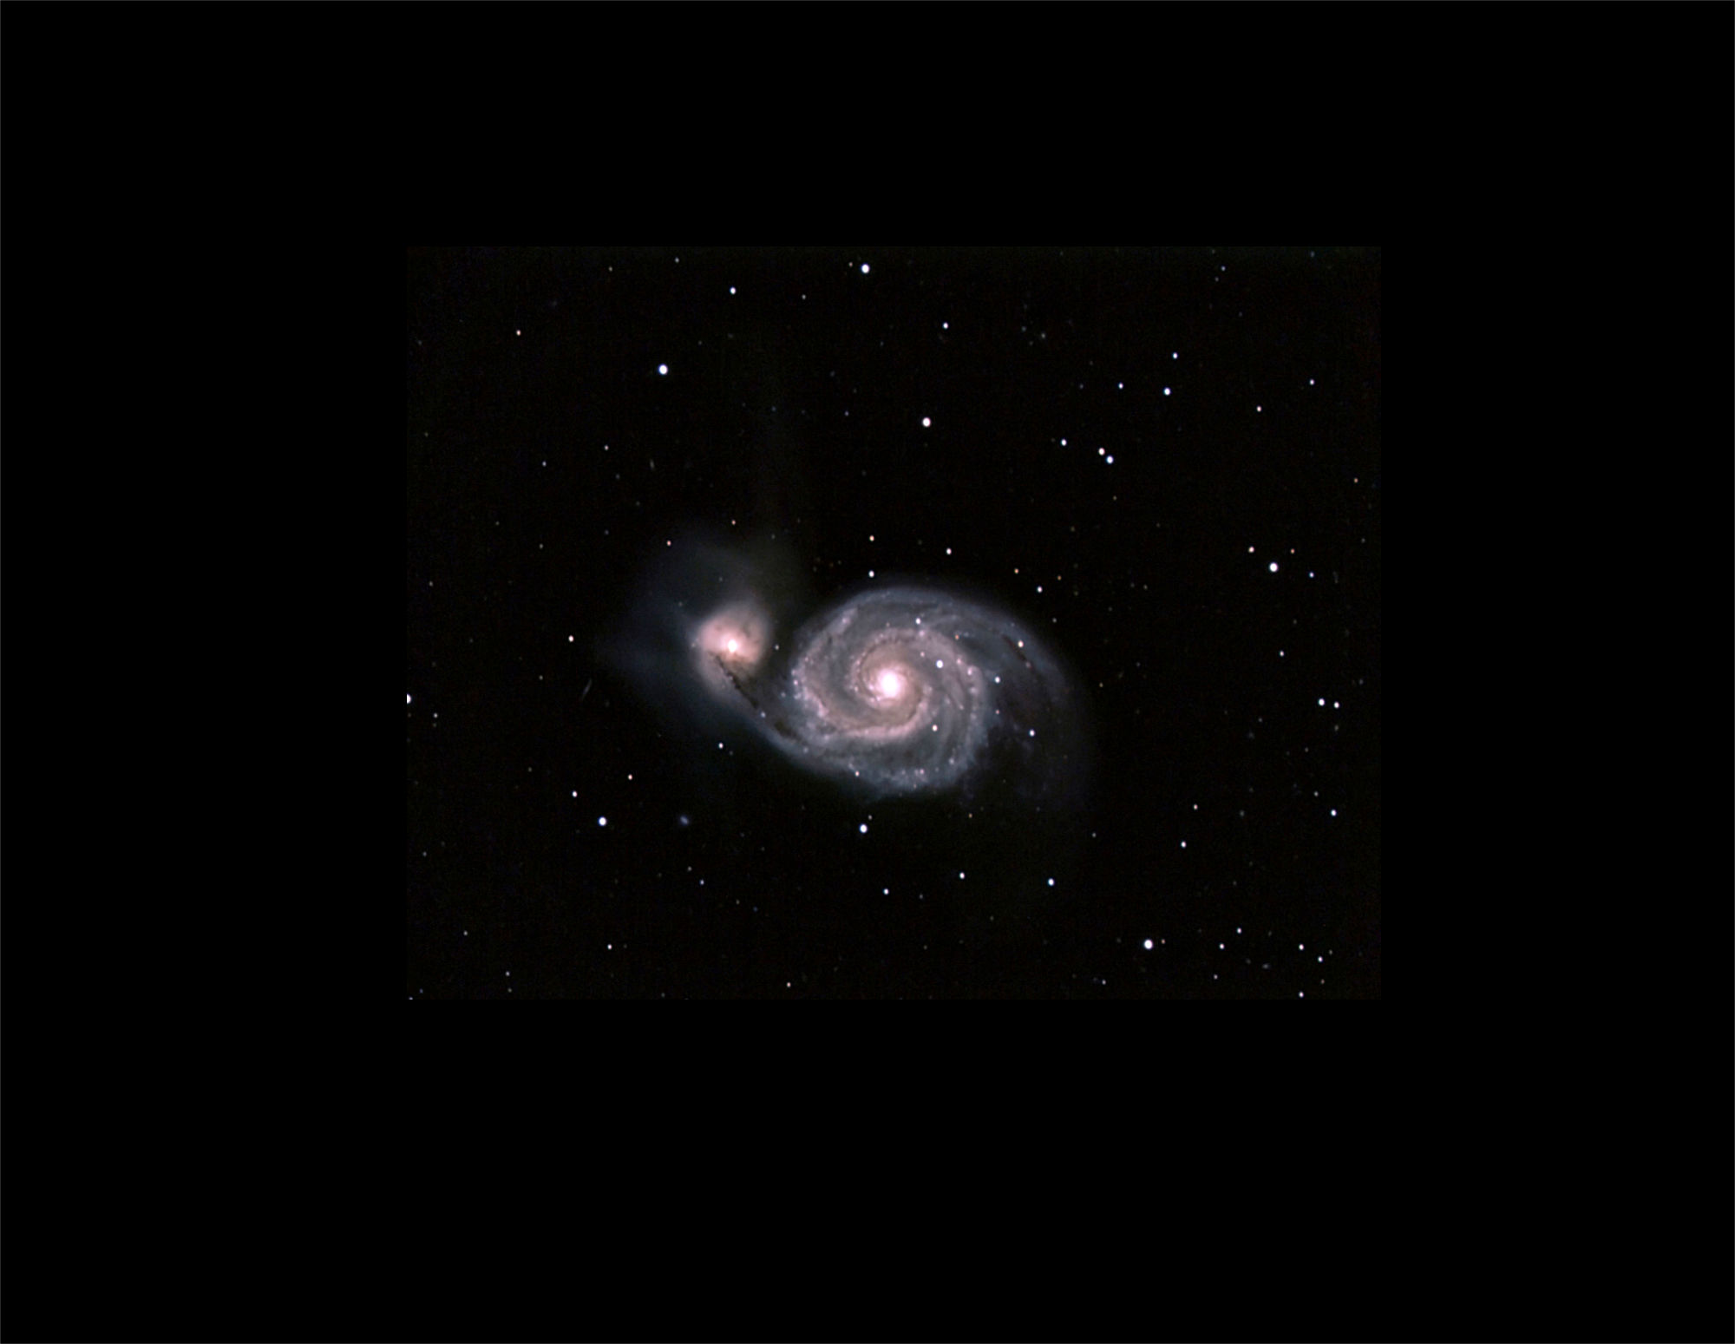
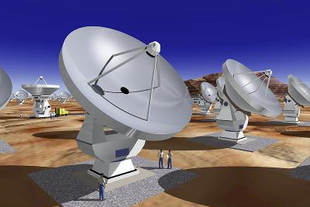
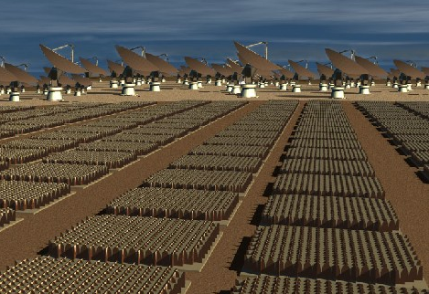
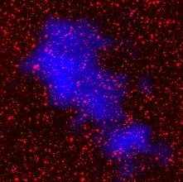
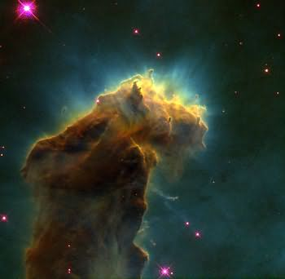
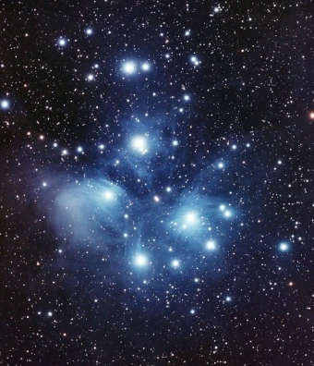
Neutral molecular gas
(STScI, OVRO, IRAM )
HST / JWST / ELT
ALMA / LMT
SKA + Pathfinders
HI
H₂
Stars
30 kpc
Neutral atomic gas
(Rots et al. 1990)
Images courtesy of Danail Obreschkow
Notes:
Sticking point: All three baryonic components of galaxies matter.
Transition: The cosmic evolution of this process is a lot of interest and is currently obscure…

Slide 4
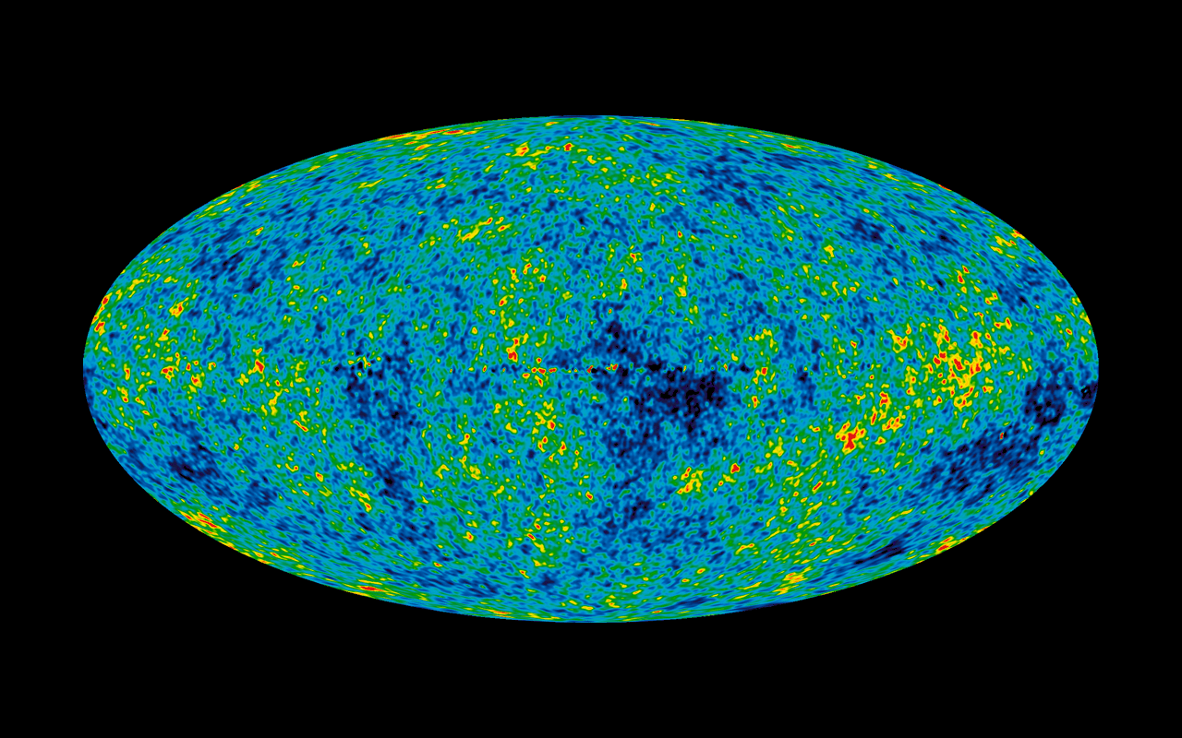
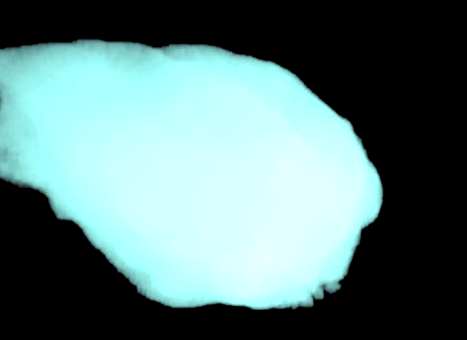
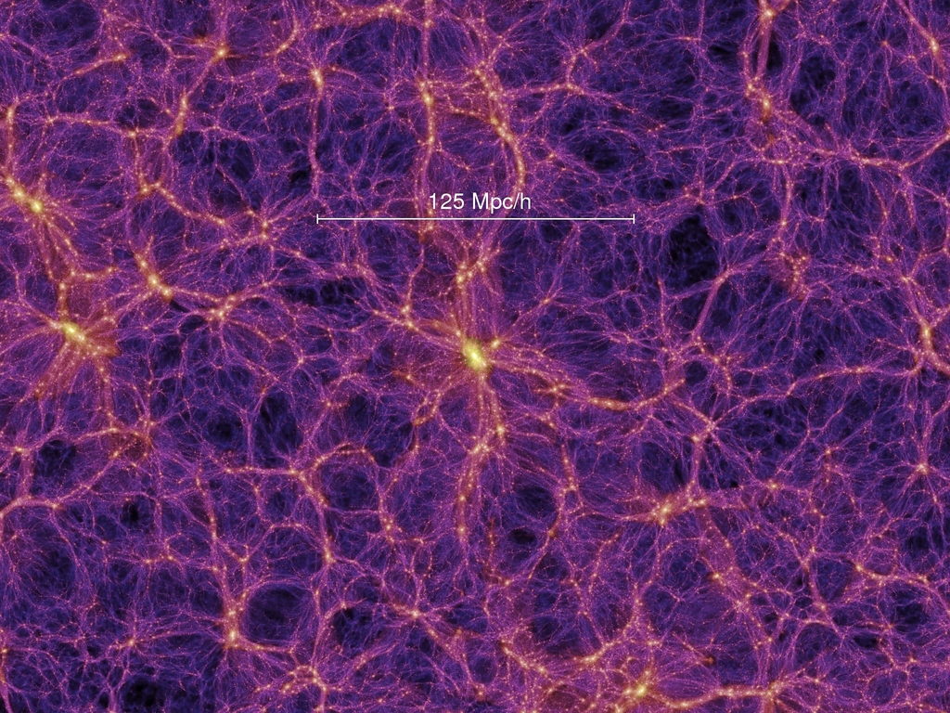
Prediction: Dark Matter
versus
Postdiction: Baryons
sub-grid
WMAP
resolution: ~ 100 pc
convert gas to stars: n ~ 0.1-1 cm-3
recipes
ab initio
theory
dark matter distribution
Springel et al. (2005)
Movie Credit: Fabio Governato
How can we test the initial conditions for galaxy formation?

Slide 5
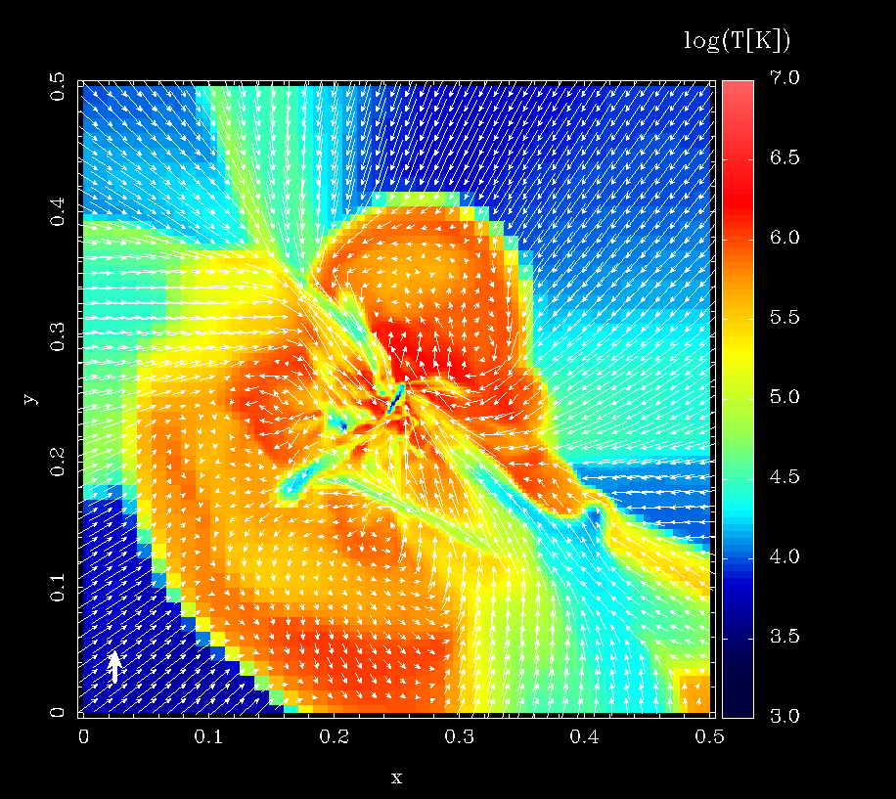
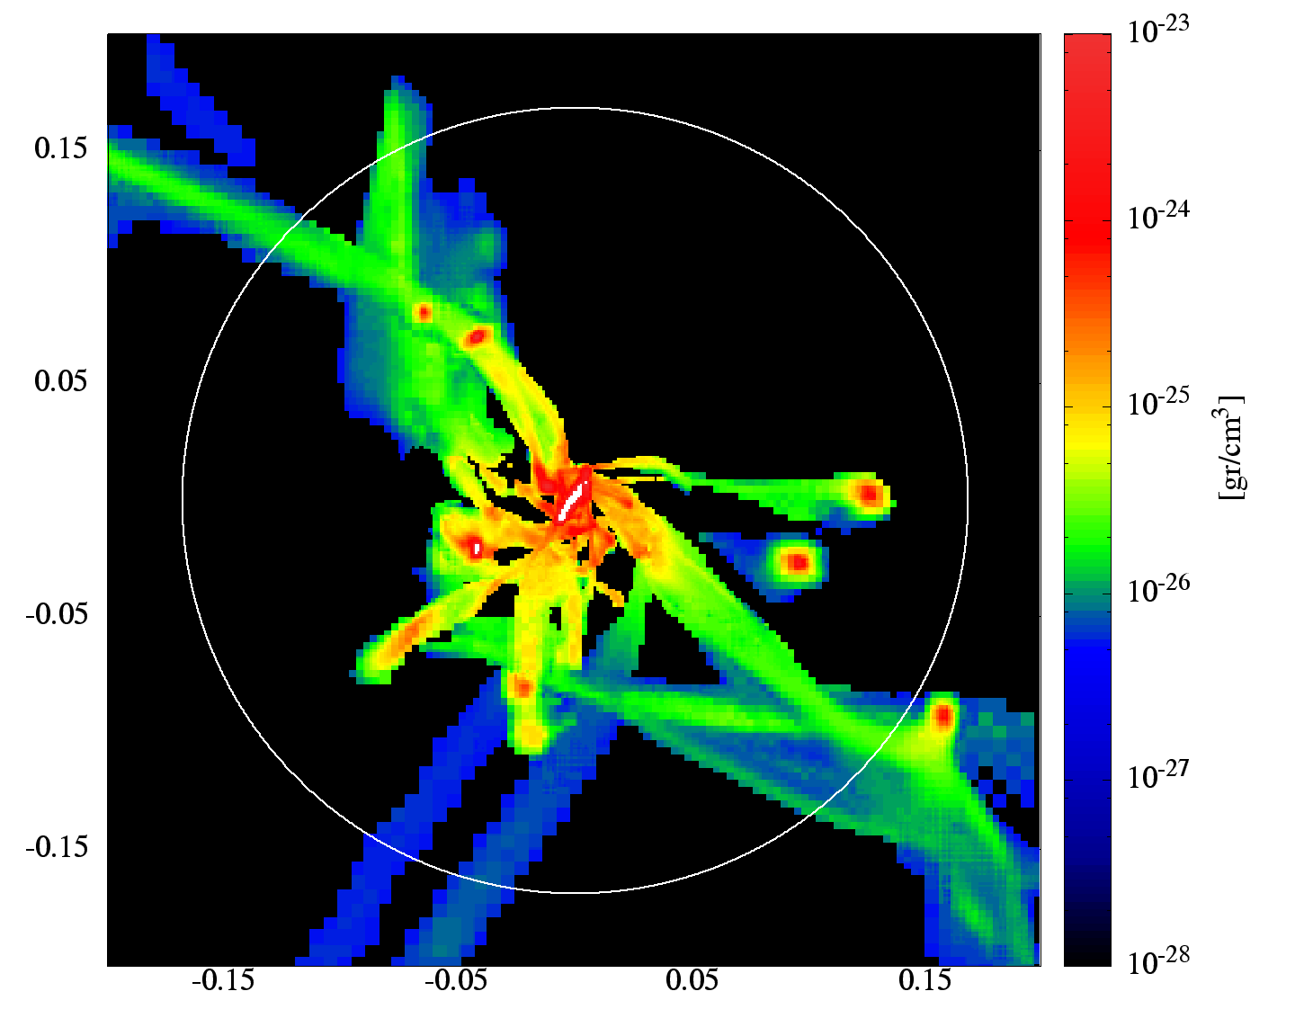
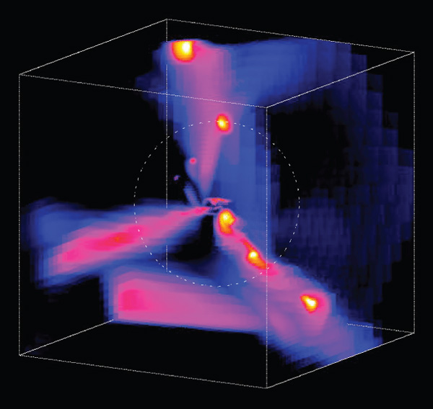
The Initial Conditions for Galaxy Formation
Radial Influx of Cold Streams
Cold Streams
virial radius
virial radius
b/g QSO
T< 104.5 K, ρ > 10-26.3 g cm-3
Dekel & Bernboim (2006)
Dekel et al. (2009)
Hydro sims predict M~1012 M halos have a ~ 30% covering factor of cold gas with column N_{H} > 1020 cm-2

Slide 6
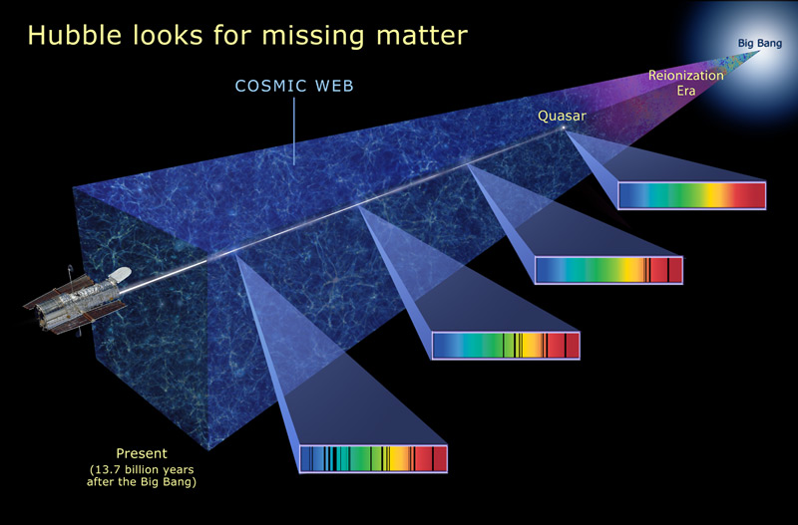
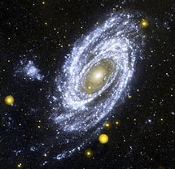
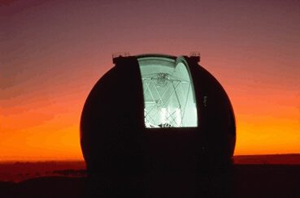
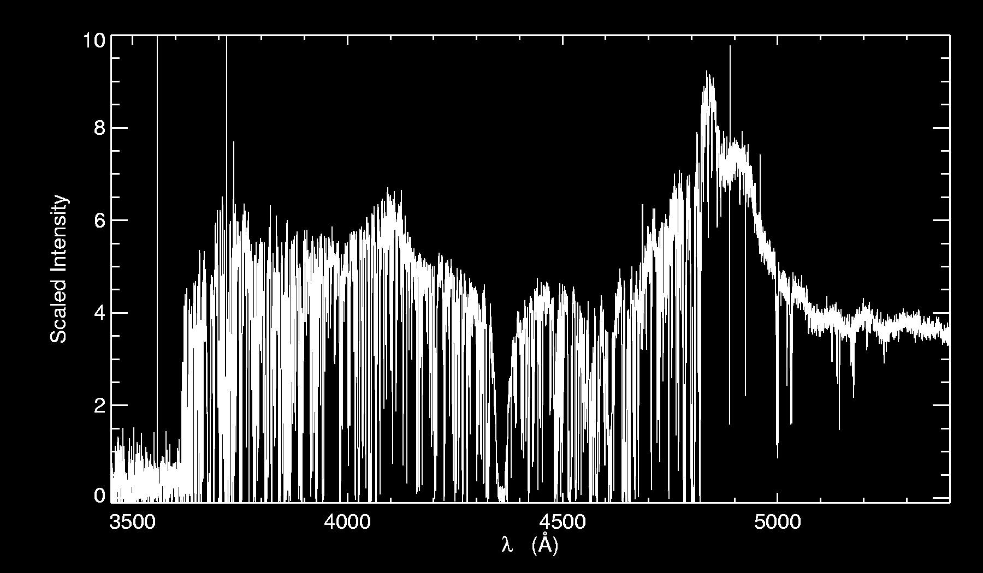
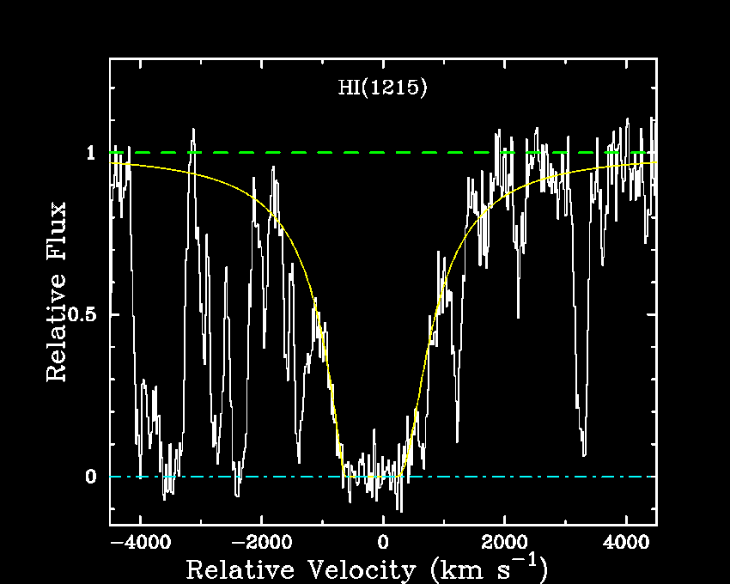
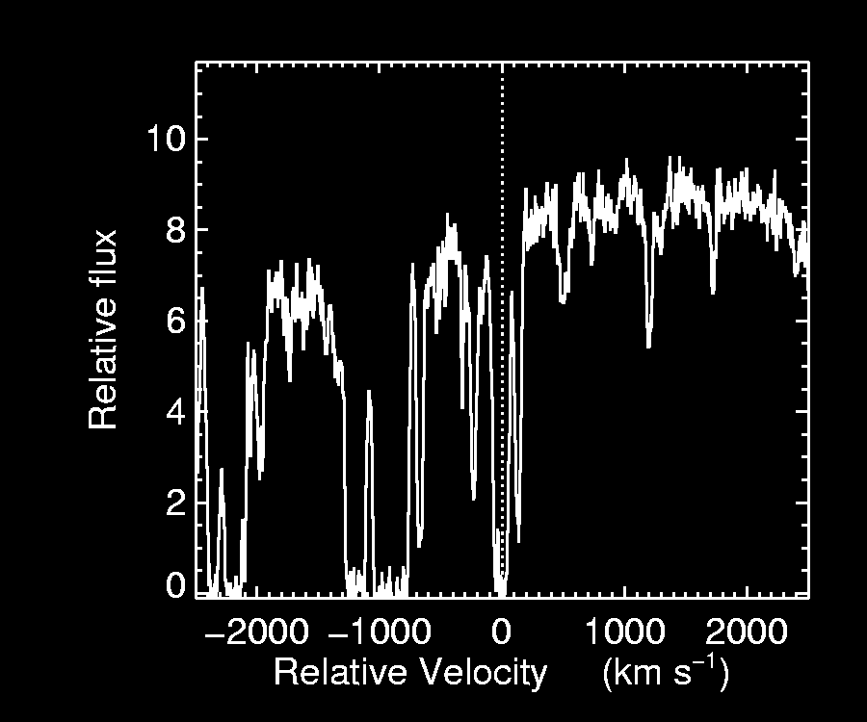
Quasar Absorption Lines
Lyα Forest
  Optically thin diffuse IGM
  ρ/⟨ρ⟩ ~ 1-10; 1014 < N_{HI} < 1017.2
  photoionized gas T ~ 104 K
Lyman Limit Systems (LLSs)
  Optically thick τ₉₁₂ > 1
  1017.2 < N_{HI} < 1020.3
  photoionized gas T ~ 104 K
Damped Lyα Systems (DLAs)
  N_{HI} > 1020.3 ~ galactic disks
  sub-L∗ galaxies?
  neutral gas, T ~ 100-5000 K
Lyα Forest
DLA
LLS
R⊥> 1 Mpc
R⊥~ 100 kpc
R⊥~ 20 kpc
Lyman Limit
z = 2.96
Lyα
z = 2.96
Lyα
z = 2.58
QSO
z = 3.0
DLA
LLS

Slide 7
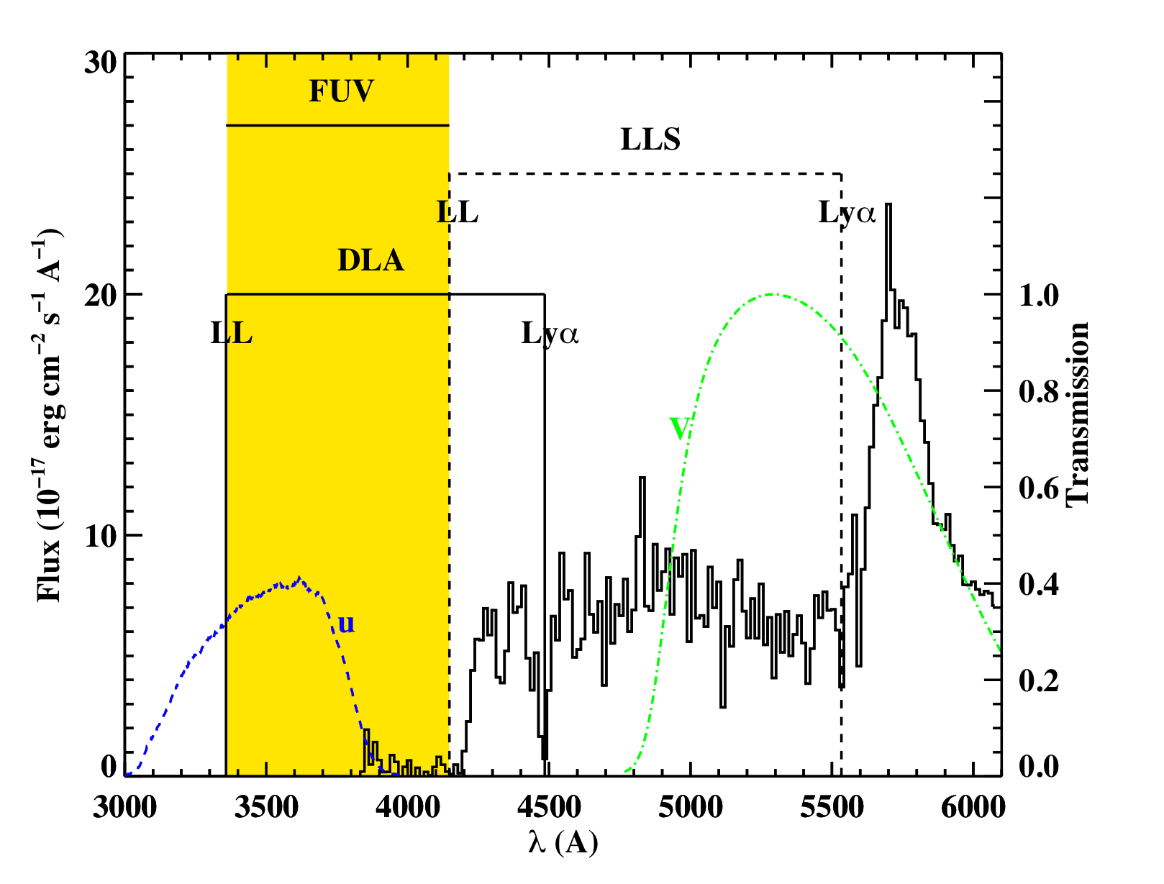
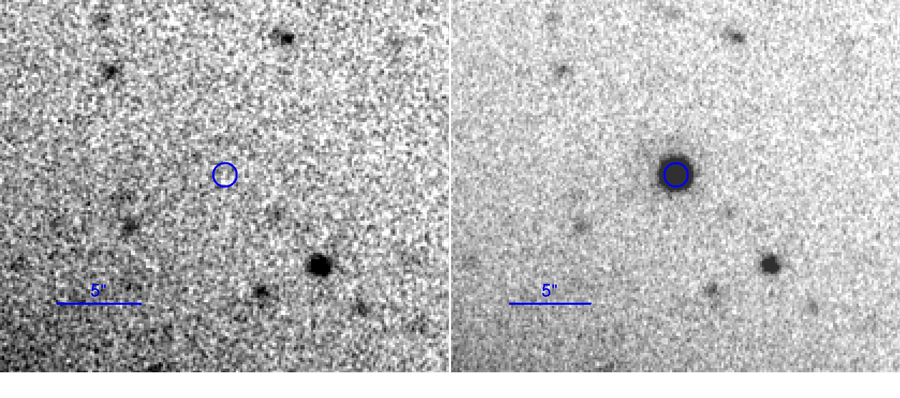
Directly Identifying Absorber Galaxies
U-band image
U < 27.8
V-band image
QSO
QSO
Ab initio theory for DM, sub-grid for baryons
Fumagalli et al. (2010)
Absorption selects by covering factor, faint end dominates
Typical counterpart r ~ 27 (L ~ 0.1L*), follow-up extremely hard
Multiple counterparts, assignment ambiguous
No dynamic range in galaxy type and/or dark halo mass

Slide 8
Quasars Probing Quasars
Use absorption lines to probe diffuse gas
r ~ 30 – 200 kpc
background QSO
r_{vir} ~ 200 kpc
THIS TALK
Virial Radius
Cold Streams?
Cold Streams?
N_{HI} ~ 1012-22 cm-2
and T ~ 102-6 K
foreground QSO halo
Cold Streams?
T ~ 106-7 K virialized plasma
Ω
Use foreground QSOs to trace massive galaxies at high-z
Why use QSOs? Because we can find ~ 106 in SDSS
Directly probe gas ρ/⟨ρ⟩ ~ 102-3 resolved by hydro grids
Complications: ionizing radiation, are QSOs atypical?

Slide 9
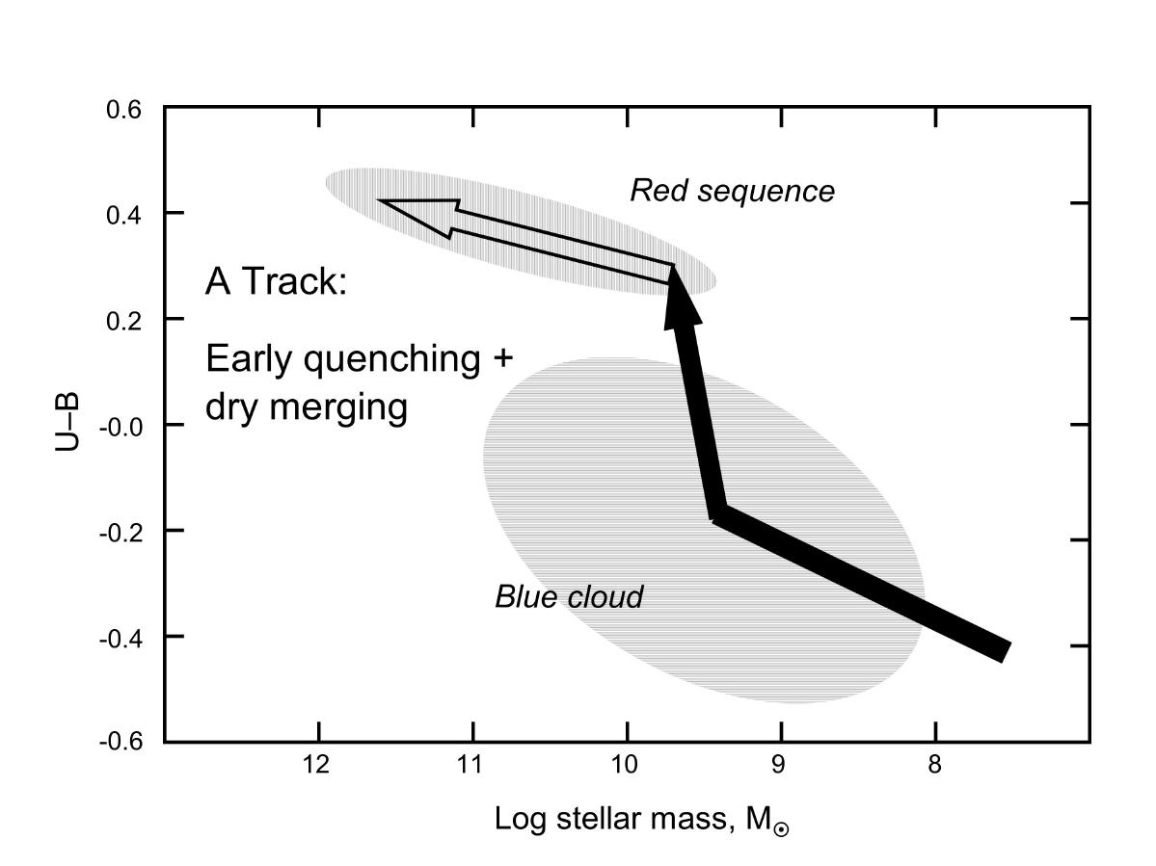
What Quenched Star Formation?
Color vs Stellar-Mass
Clustering gives dark halo mass scale z ~ 2.5
Red Sequence
dry merging
QSOs: M~1012.9 M
end up here
(Shen et al. 2008)
early
quenching?
Blue
Cloud
z ~ 2-3 star-forming
gals: M~1011.9 M
end up here.
(Conroy et al. 2007)
Faber et al. 2007
What physics gives rise to this bimodality? When did quenching occur? QSOs at z ~ 2-3 are the progenitors of local massive red-and-dead galaxies.

Slide 10
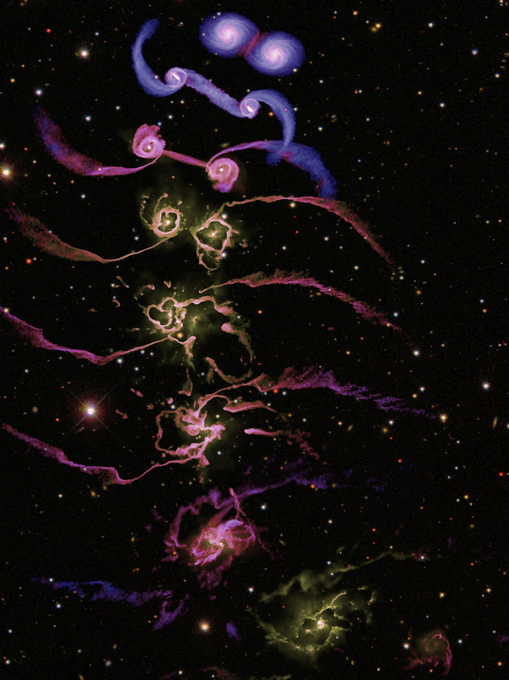
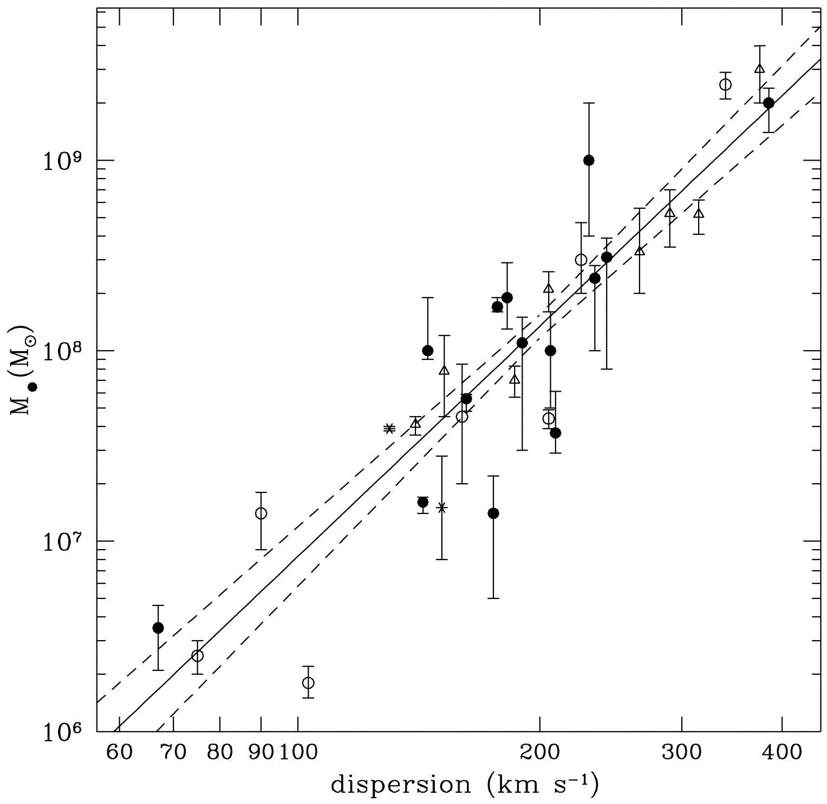
Quasar Feedback?
Progenitors
Relics
Tremaine et al. (2002)
Black Hole Mass
5% coupling to accretion power
Host Velocity Dispersion
radiated energy
Springel et al. (2005)
There is no observational evidence that accretion energy couples to large > 1 kpc scales in typical QSOs.

Slide 11
Fundamental Questions
What is the physical state of gas in the high-z progenitors of red-and-dead galaxies?
Is there evidence for cold flows? What is the supply of T ~ 104 K gas?
Is feedback occurring in the typical QSO?
If so how far does feedback energy, material, metals travel in ISM/halo?
How does feedback energy correlate with accretion power?
b/g QSO
QSO
ISM/halo
f/g QSO
R⊥
Ω
We have never studied QSOs or massive high-z DM halos M ~ 1013 M in absorption before.

Slide 12
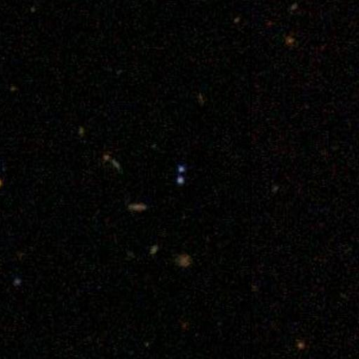
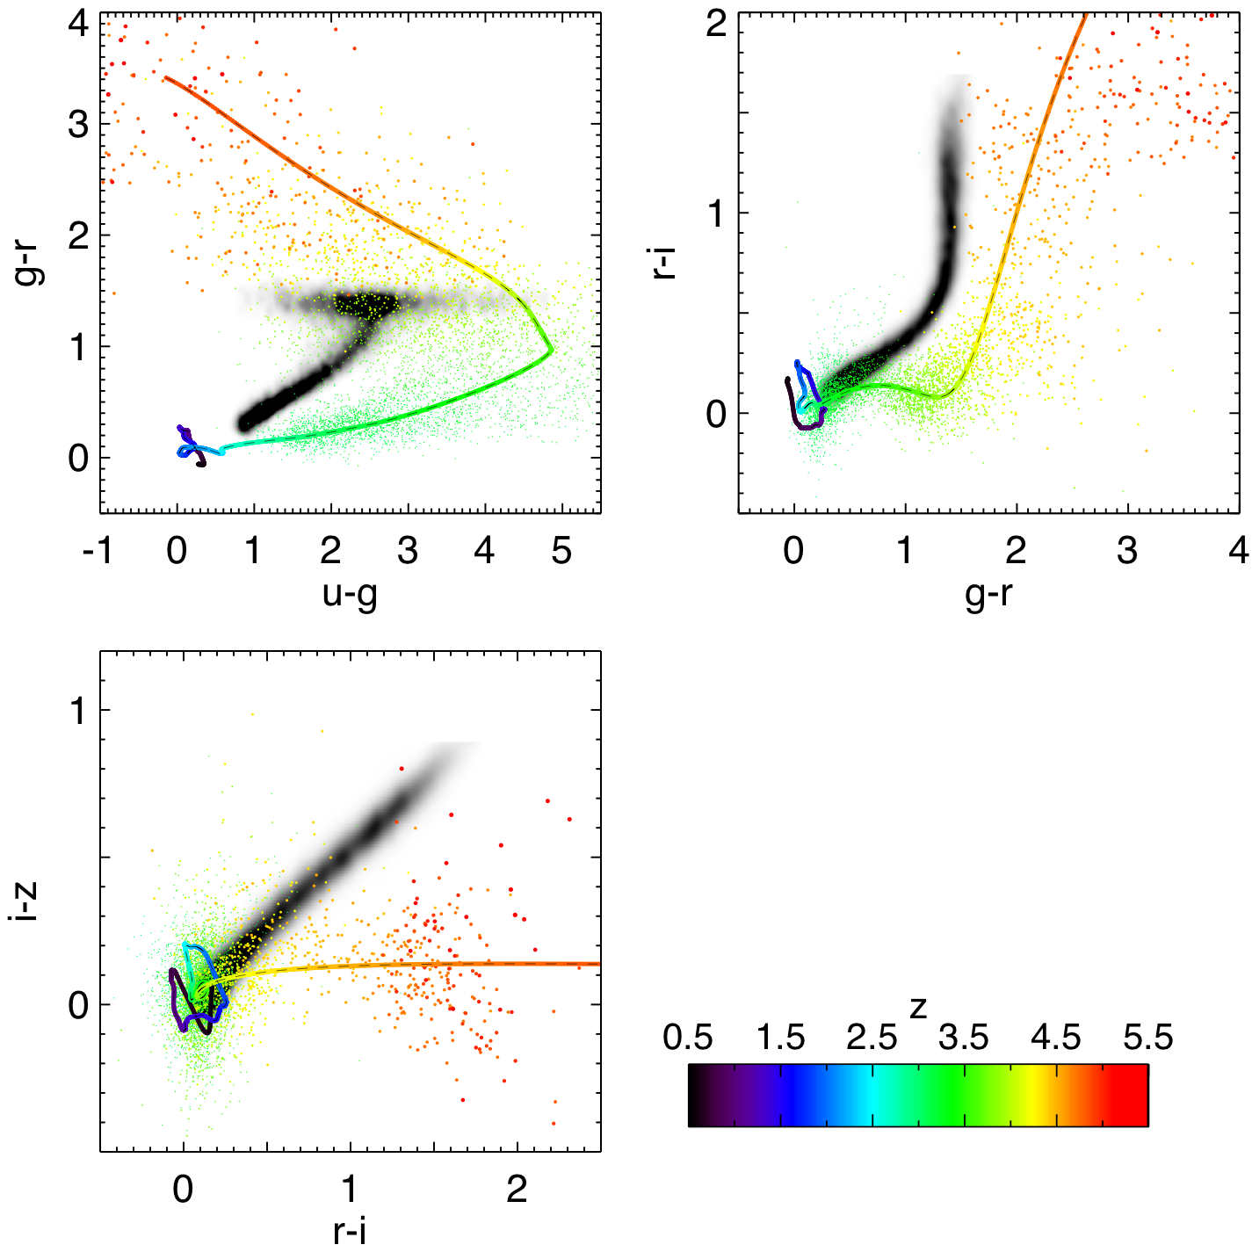
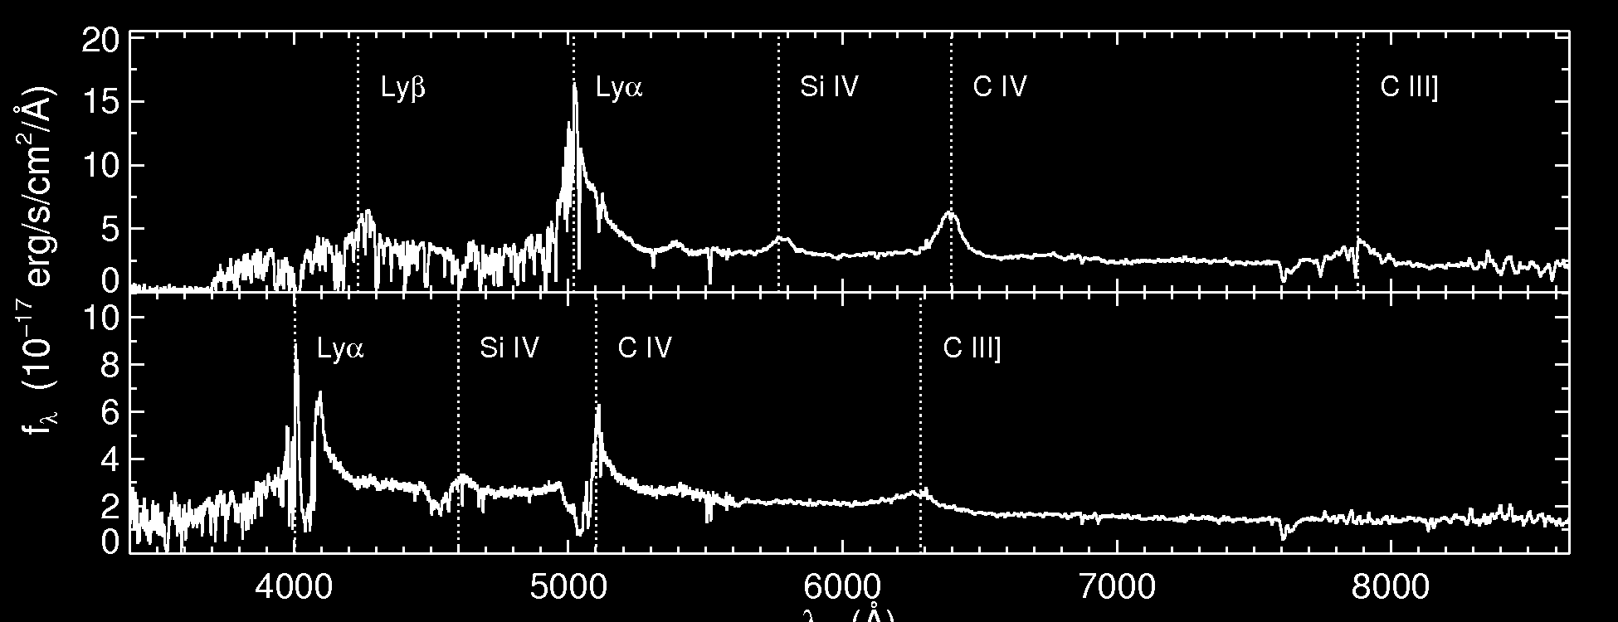
Finding Projected Quasar Pairs
At z ~ 2 one R⊥ < 250 kpc pair per ~ 50 deg². Must mine SDSS.
Spectroscopic QSOs (9000 deg²)
  45,000 z < 2.2 QSOs to i < 19.1
  5,000 z > 3 QSOs to i < 20.2
Photometric QSOs (9000 deg²)
  10⁶ z < 3 QSOs to i < 21.3
  30,000 z > 3 QSOs to i < 21.3
  Bovy, Hennawi et al. (2010)
Δθ = 3.7”
55”
2’
z =3.13
Excluded
Area
SDSS QSO @ z =3.13
b/g QSO z = 3.13
f/g QSO z = 2.29
  Hennawi et al. (2006,2009)
Keck LRIS spectra
λ (Å)

Slide 13
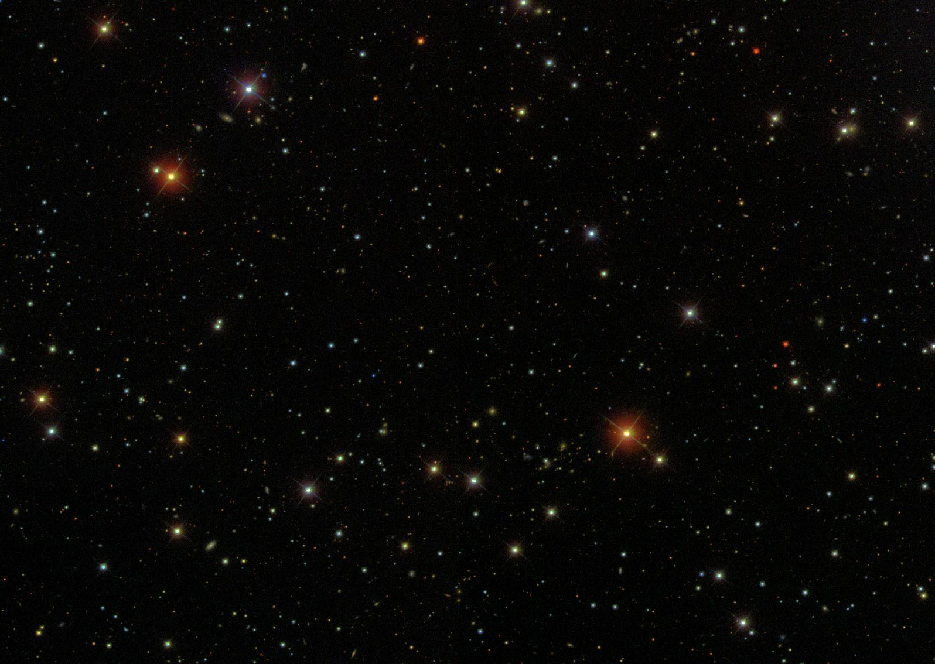
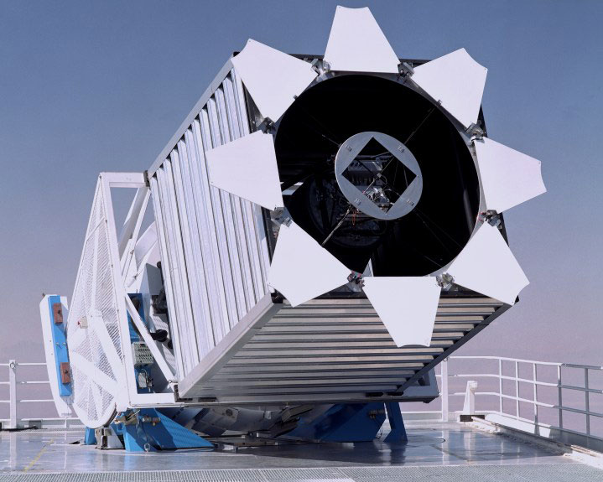
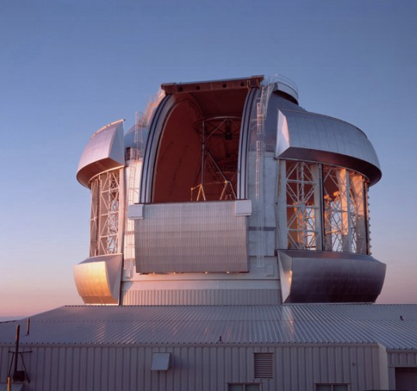
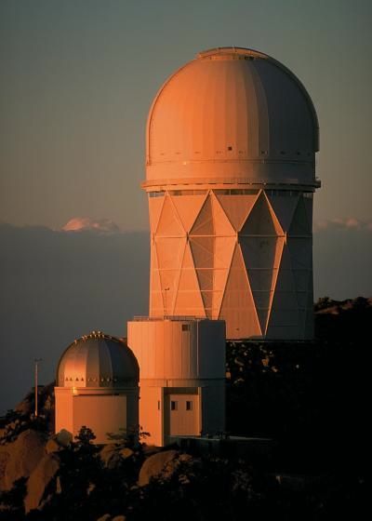
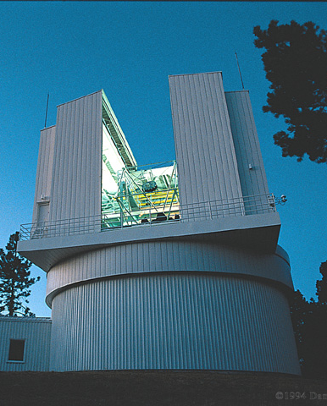
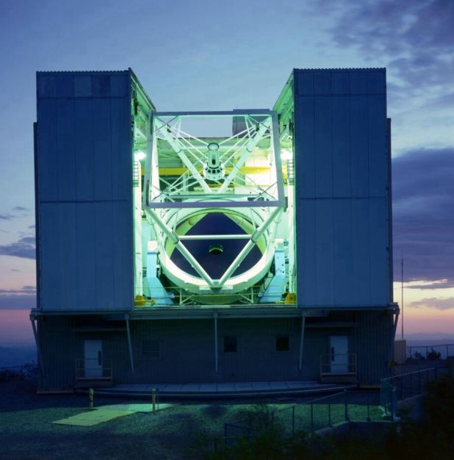
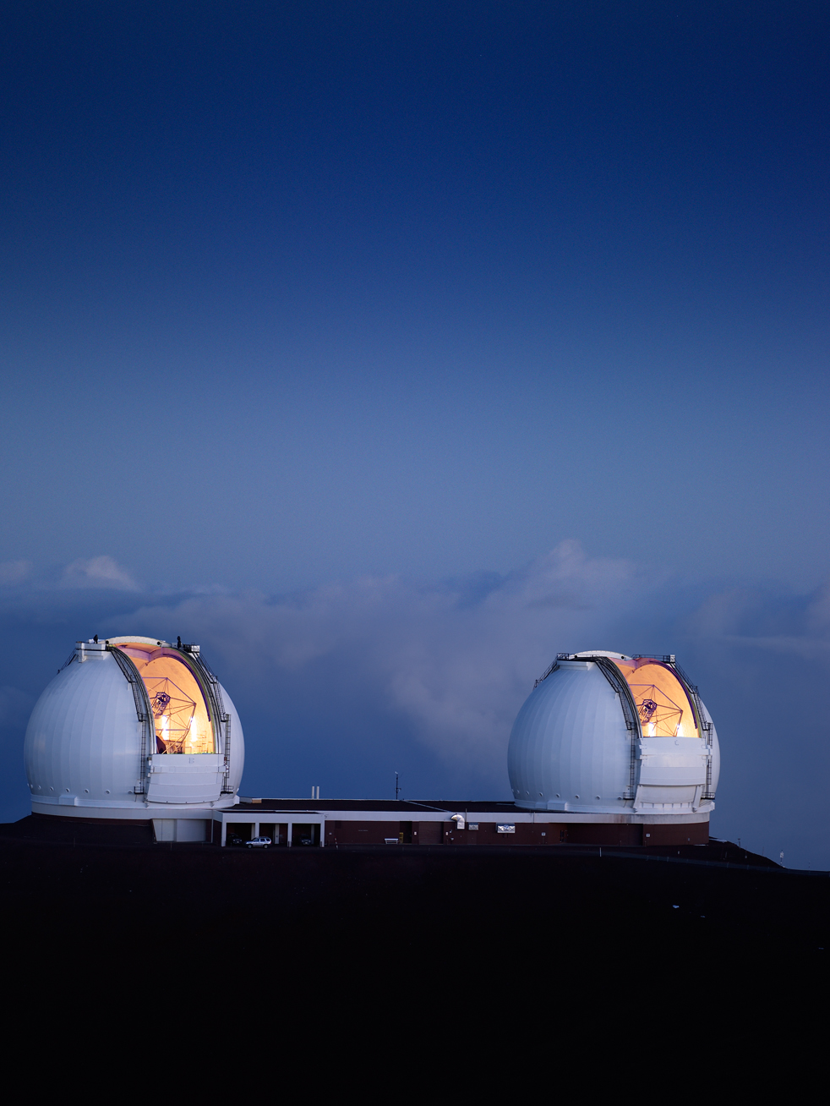
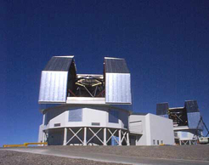
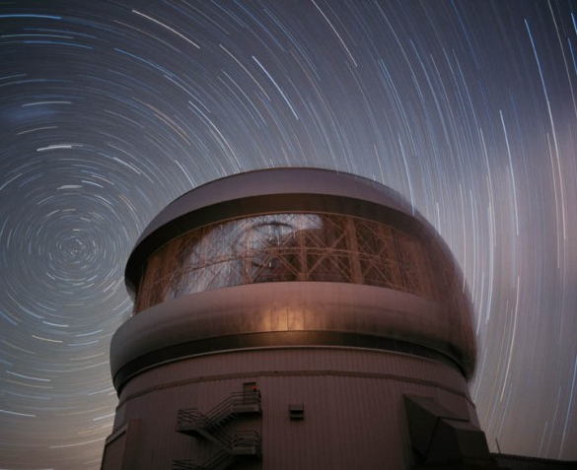
Cosmology with Quasar Pairs
Science Goals
¼ Sky SDSS imaging
~106 QSO candidates
Small scale QSO clustering
Small scale Lyα forest
Topology of metal enrichment
Transverse proximity effect
Study QSOs in absorption
Pair Confirmation: 4m Telescopes
Science Spectra: 8m telescopes
Gemini N
Keck
Magellan
Gemini S
APO
MMT
KPNO
> 200 new pairs R⊥ < 500 kpc, increase # known by factor 40
Obtained > 60 nights of optical & near-IR spectroscopy

Slide 14
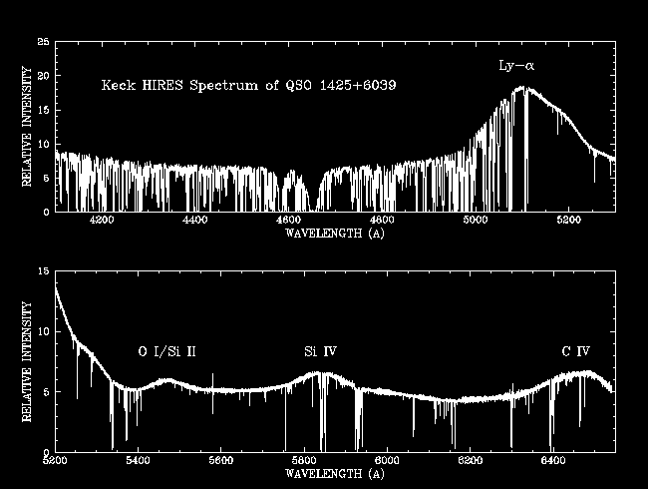
Where is the Host Galaxy?
Spectrum from Wallace Sargent
  No strong Lyα absorption at QSO redshift?

Slide 15
What is the Supply of Cold Gas?
No Cold Gas
Cold Gas Zapped
Lots of Cold Gas
b/g QSO
cold gas
b/g QSO
b/g QSO
f/g QSO
f/g QSO
f/g QSO
R⊥
R⊥
R⊥
QSO ionizing radiation
Measure covering factor of cold T ~ 10⁴ K gas. Large column density (optically thick) absorbers will dominate total density.

Slide 16
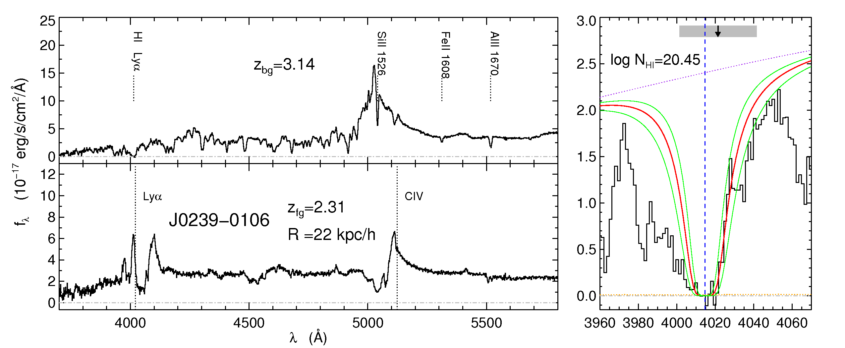
Quasars Probing Quasars
z_{bg} = 3.13; z_{fg}= 2.29; R⊥ = 31 kpc; logN_{HI} = 20.5
b/g QSO
f/g QSO
Hennawi et al. (2007)

Slide 17
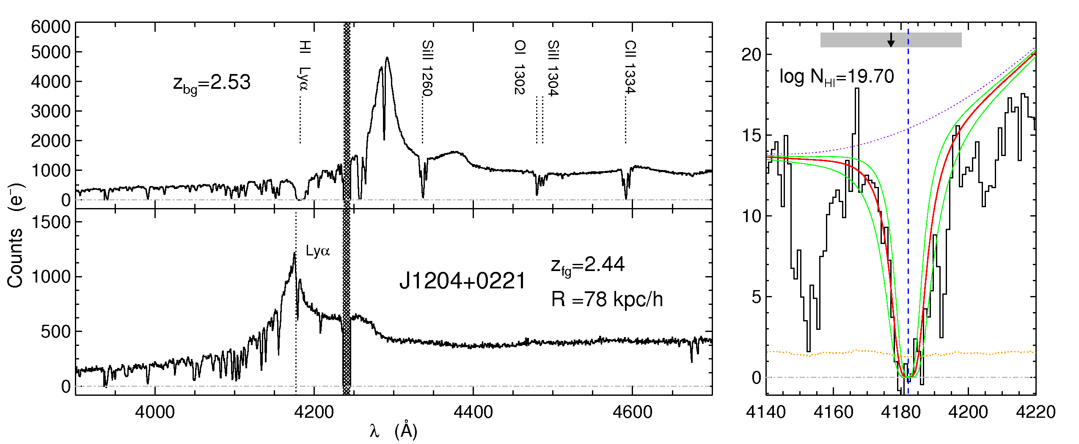
Quasars Probing Quasars
z_{bg} = 2.53; z_{fg}= 2.43; R⊥ = 109 kpc; logN_{HI} = 19.7
b/g QSO
f/g QSO
Hennawi et al. (2007)

Slide 18
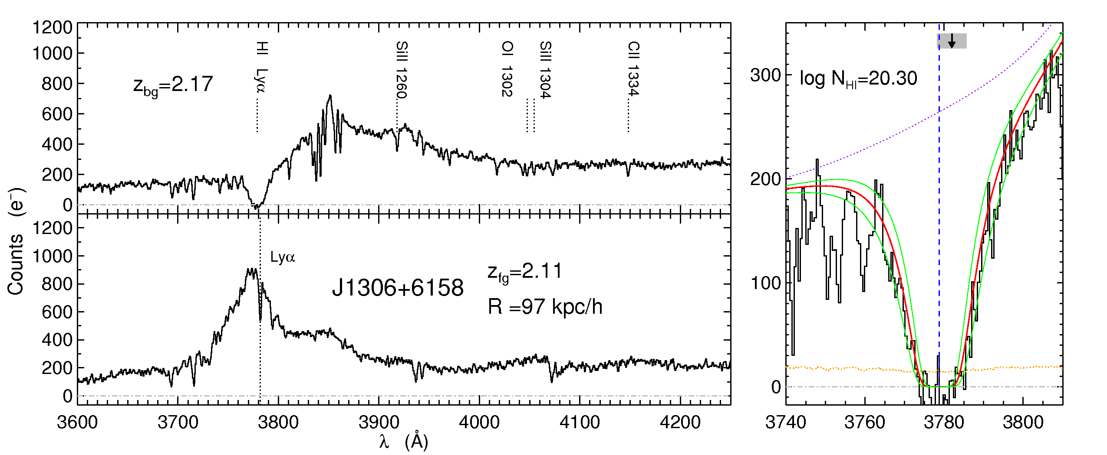
Quasars Probing Quasars
z_{bg} = 2.17; z_{fg}= 2.11; R⊥ = 139 kpc; logN_{HI} = 20.3
b/g QSO
f/g QSO
Hennawi et al. (2007)

Slide 19
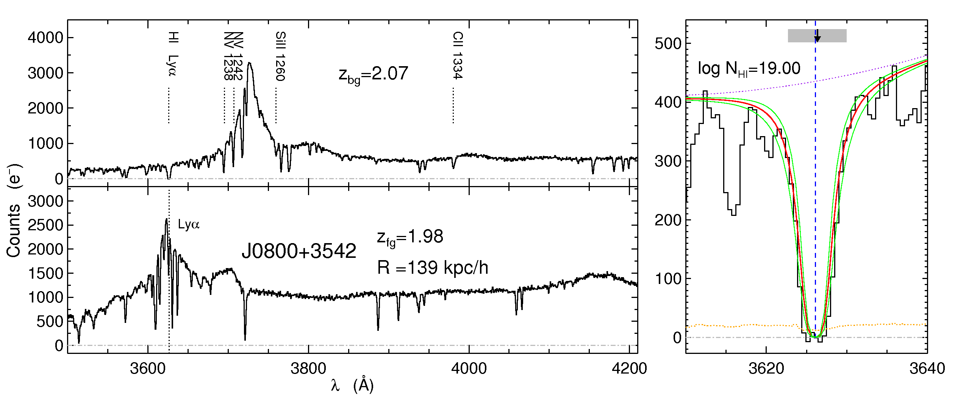
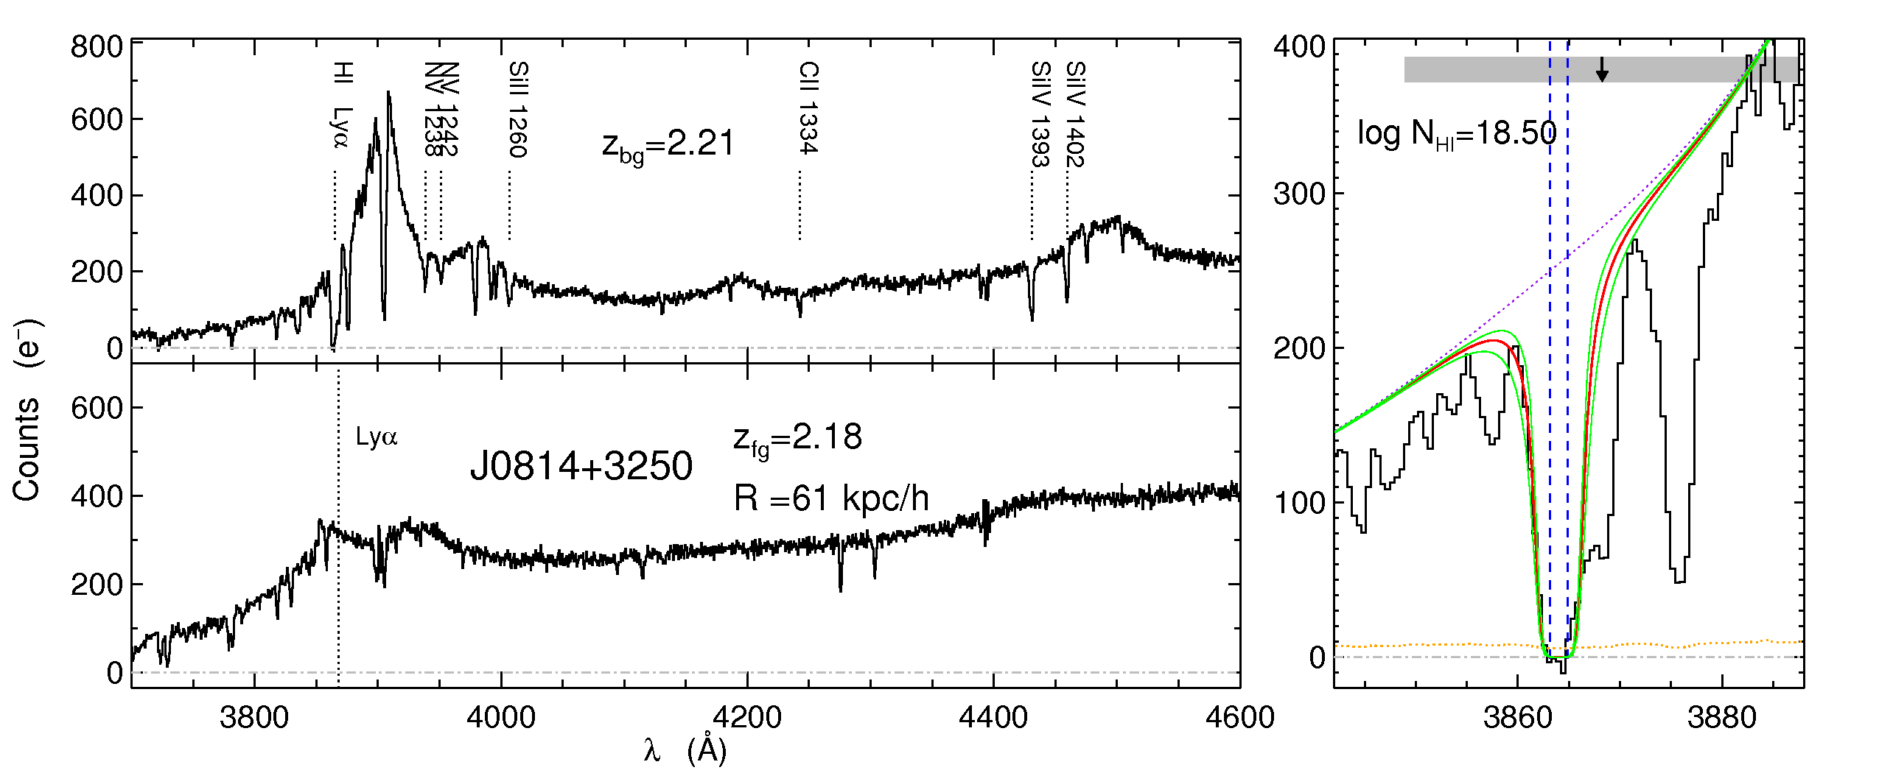
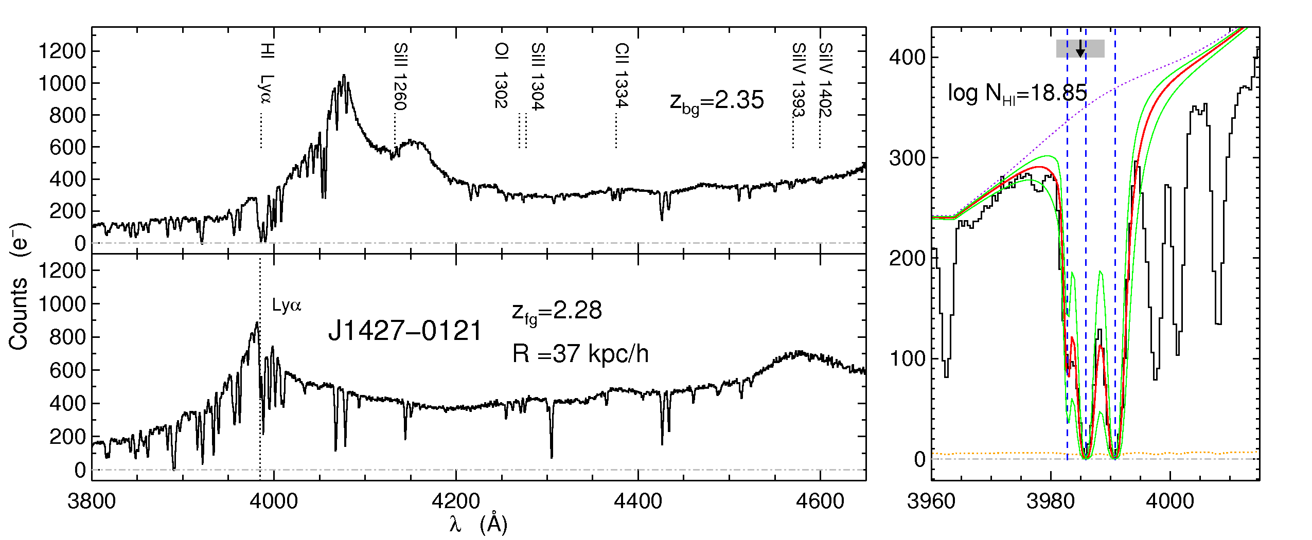
Quasars Probing Quasars
z_{bg} = 2.07; z_{fg}= 1.98
R⊥ = 199 kpc; logN_{HI} = 19.0
z_{bg} = 2.35; z_{fg}= 2.28
R⊥ = 53 kpc; logN_{HI} = 18.9
z_{bg} = 2.21; z_{fg}= 2.18
R⊥ = 87 kpc; logN_{HI} = 18.5
Hennawi et al. (2007)

Slide 20
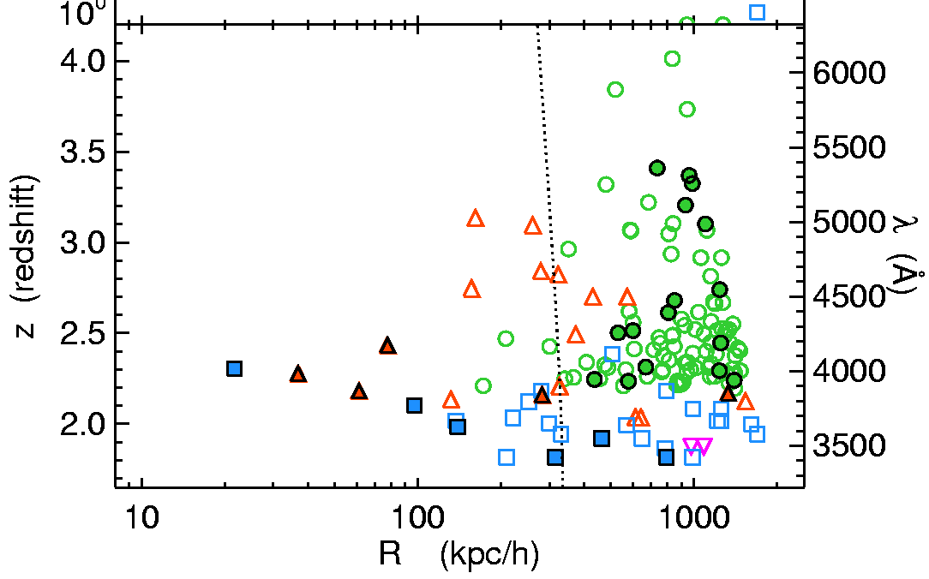
High Transverse Covering Factor
= Keck
ξ_{T}(r) = (r/r₀)-γ, γ = 1.6, r₀ = 9.2 ± 1.7 Mpc/h
= Gemini
= SDSS
=
filled has
absorber
open has
=
no absorber
Hennawi et al. (2007)
Hennawi & Prochaska (2007)
High covering factor for R < 100 kpc/h
This cold gas is not seen along the line-of-sight!

Slide 21
Anisotropic Covering Factor
Clustering of absorbers around quasars is highly anisotropic.
Anisotropic (or intermittent) emission:
  line-of-sight material photoevaporated
  transverse material shadowed
Background sightlines probe ISM/halo gas unaltered by effects of QSO radiation
b/g QSO
cold gas
f/g QSO
R⊥
QSO ionizing radiation
transverse
For individual systems, we can directly test for transverse illumination (stay tuned).
line-of-sight

Slide 22
What is the Physical State of the Gas?
b/g QSO
b/g QSO
b/g QSO
b/g QSO
R⊥
R⊥
Cold
Streams?
R⊥
R⊥
f/g QSO
f/g QSO
f/g QSO
f/g QSO
Outflow or Cold Flows?
Cloud Density, Size, Pressure?
Multiphase? Cold, Warm, Hot?
Distribution of Metals?
Use high resolution spectra to conduct detailed studies of the physical state of gas near the foreground quasar.

Slide 23
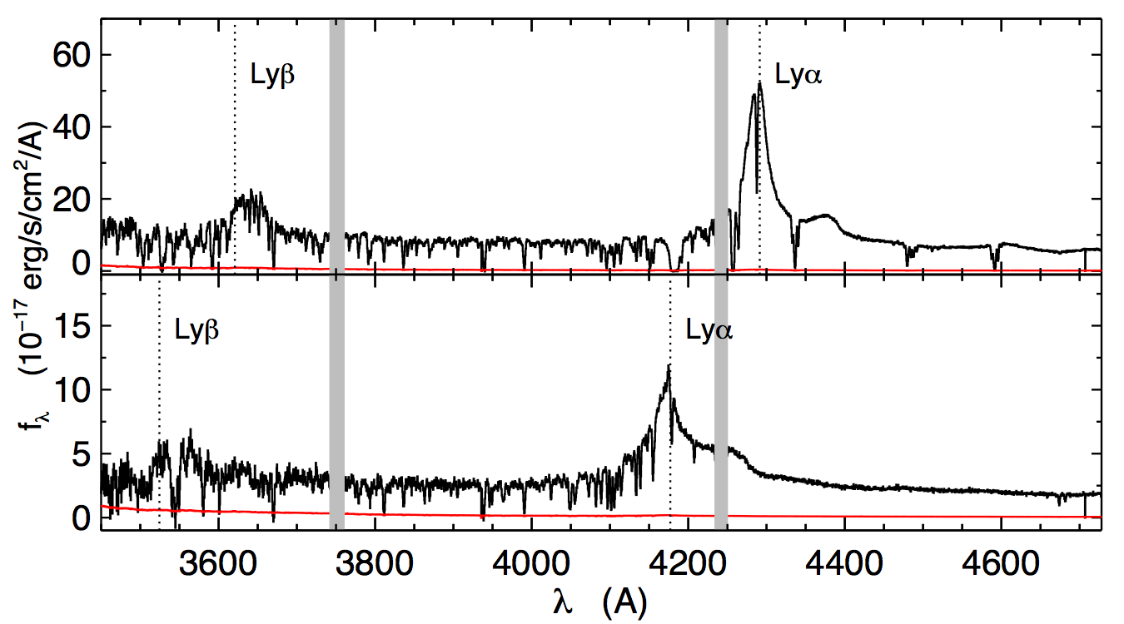
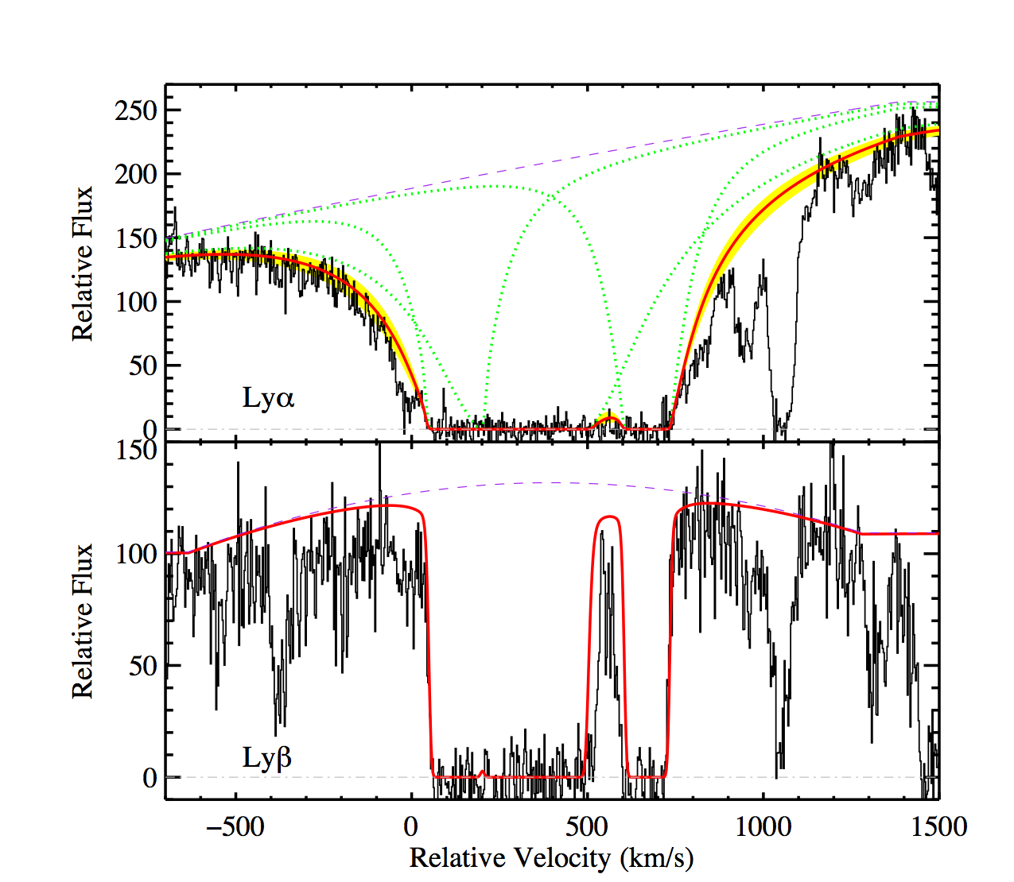

What is the Physical State of the Gas?
SDSSJ1204+0221
Δθ = 13.3” or R⊥= 108 kpc
Lyman limit system: log N_{HI} = 19.7
b/g QSO
z = 2.53
ccd gap
Keck HIRES Echelle Spectrum FWHM = 8 km/s
f/g QSO
z = 2.44
Lyα
z =2.4360±0.0005
z-systemic from near-IR H-band spectrum
[OIII] λ5007
Lyβ
b/g QSO bright enough (r = 19.0) for Echelle Spectroscopy!

Slide 24


SDSSJ1204+0221: Metal Lines
Prochaska & Hennawi (2009)
How do we interpret all of this information?

Slide 25

Absorption Line Physics
Photionization
Ionizing radiation sets relative strength of ionic transitions. Determine ionization corrections and hence total gas mass
Radiation
More Neutral
High Ions
Intermediate Ions
Low Ions
CIV, SiIV
NV, OVI
NII,CII, SiII
SiIII, FeIII, AlIII
OI, NI
OI
OII
OIII
OIV
OVII
Collisional Ionization
Collisions with free electrons sets strength of high ions. Measure amount of gas in warm phase T ~ 105-106 K
0
-1
OV
OVI
-2
Log Fractional Abundance
-3
-4
104
104.5
105
105.5
106
T_{CIE}(K)
Collisional Excitation
Collisions with free electrons excite fine structure levels. Measure electron density
Fine Structure of C+ ion
CII* λ1335
J=3/2
ΔE
J=1/2
CII λ1334
ΔE = 0.008 eV, λ = 158μm, T = 92 K

Slide 26


Collisional Ionization
Degree of collisional ionization set only by temperature
b/g QSO
Hot virialized halo
Fractional Oxygen Abundance
Column Densities for CIE
f/g QSO
OI
OII
OIII
OIV
OVII
T_{vir}
0
CIV
-1
OVI
SiIV
OVI
Log Fractional Abundance
detection limits
-2
OV
-3
NV
-4
104
104.5
105
105.5
106
T_{CIE}(K)
T_{CIE}(K)
So we can measure gas column in “warm” phase 105 K< T_{vir}< 106 K. Need X-ray observations to detect T_{vir} > 106 K.

Slide 27


Collisional Ionization
In this simulation we tie the bulk motion (line width) to temperature via the virial relation
and vary virial temperature.
Virialized hot gas shows high-ion transitions with large “mechanical” broadening from bulk random motions.

Slide 28


Collisional Excitation
Energy Levels of CII ion
UV photon
excited states
CII λ1334
N_{CII*}/N_{CII}
CMBR z = 5
n_{crit}
z = 4
CII* λ1335
z = 3
z = 2
J=3/2
ground state split by fine structure
ΔE
J=1/2
ΔE = 0.008 eV, λ = 158μm, T = 92K
n_{e} (electron density)
electron density
Silva & Viegas 2002
=1
column ratio
critical density
thermodynamic equilibrium
Populated by electron collisions, 158μm CMB photons, UV pumping
Temperature independent! So we can measure electron density.
Dynamic range from CII*, SiII*, and FeII* 10-2 cm-3 < n_{e} < 105 cm-3.

Slide 29
SDSSJ1204+0221: Metal Lines
300 km/s
Absorption ~ 700 km/s from f/g QSO systemic extreme kinematics
Large NII/NI gas is definitely ionized
Weak narrow CIV and SiIV ionization level is not extreme
Detection of fine structure line CII* 1335 we can measure n_{e}
No compelling broad NV or OVI no warm gas T ~ 105-106 K

Slide 30
Properties of the Cold Gas
Property
Value
Anomalous for absorbers?
Neutral Column | N_{HI} = 10^{19.65} cm⁻² | Typical
Total Column | N_{H} = 10^{20.6} cm⁻² | Typical (n_{HI}/n_{H} = 0.1)
Total Mass | M ~ 3×10¹¹ M | Little is known
Velocity Field | Δv = 700 km/s | High. 99%-ile of absorbers
Metallicity | Z = (0.25-1.6) Z | High. 99%-ile of absorbers. Seen only in AGN or starburst gals
Number Density | n_{H} ≈ 1-5 cm⁻³ | Little is known
Temperature | T ≈ 10,000 K | Typical of ionized gas
Pressure | nT ≈ 4×10⁴ cm⁻³ K | Little is known
Ionizing Flux | Φ < 10^{6.5} photons s⁻¹ cm⁻² | Typical. No QSO illumination!
Cloud Radius | R ≈ 10 -100 pc | Little is known
Covering Factor | C ≈ 0.25 - 1.0 | Little is known
Filling Factor | C_{V} ≈ 10⁻⁵ -10⁻⁴ | Little is known

Slide 31

Is there a Virialized Halo?
QSO mass scale M ≈ 1013 M. ΛCDM model predicts a virialized halo with
b/g QSO
Hot virialized halo
f/g QSO
T_{vir}
Collisional ionization strength of high-ions (NV, OVI) determined only by temperature
Data are consistent with expectation:
  no high ions detected ⇒ halo gas T > 106 K
  extreme absorber kinematics Δv ~ 700 km/s consistent with V_{circ} = 450 km s-1

Slide 32



Two Phase Medium
Combine statistical covering factor with photoionization model, to estimate cold gas density at r ~ 100 kpc
covering factor
ionization model of SDSSJ1204
Significant cold gas fraction ⇒ two-phase medium
We measure cold phase pressure P = nT reasonably well:
Pressure
Equilibrium!

Slide 33


Outflow or Cold Flows?
Outflow
b/g QSO
b/g QSO
Cold Flows
R⊥
R⊥
f/g QSO
?
f/g QSO
QSO feedback ejects or sweeps up cold material
Gravitational motions in two phase medium
Strongest evidence for outflow is high Z ~ Z at 108 kpc.
Outflow power
kinetic luminosity
Significant coupling to accretion! Are these energetics plausible?

Slide 34


Problems with Outflows
Cloud size, density, velocity indicate they are short lived
  Disruption by instabilities ~ 106 yr, dynamical time ~ 108 yr
Kelvin-Helmholtz & Rayleigh-Taylor instabilities
Agertz et al. (2007)
  conductive evaporation in ~ 106 yr
  cold clouds constantly forming and disrupted in outflow?
  must be significant gas mass in a hotter phase
  Why no significant warm phase T ~ 105-106 K?
  Our outflow power did not include hot phase or radiation
Extreme energetics: outflow power > 6% accretion power

Slide 35
Problems with Cold Flows
Why is the gas so metal enriched Z ~ Z?
  At z ~ 2.5 solar Z only in QSO BLRs and centers of starbursts
  Today X-ray groups have Z ~ 0.1Z at R⊥~ 100 kpc
  Too few galaxies near QSO to produce high metal cov factor
Observed n ~ 1 cm-3 >> hydro sims predict n ~ 10-2 cm-3
Cold cloud properties indicate they are short lived ~ 106 yr
  Will not survive for dynamical time ~ 108 yr. No cold flows?
  If clouds formed/disrupted then hot halo must have Z ~ Z???
Hydro simulations predict less cold gas in massive halos

Slide 36
Statistical Samples
Color vs Stellar-Mass
Red Sequence
R⊥
QSOs: M~1012.9 M
Blue
Cloud
Galaxies:M~1011.9 M
Foreground QSOs
Map out physical properties versus impact
parameter R⊥ for statistical samples
  metallicity
  kinematics
  cold (10⁴ K) and warm (10⁵⁻⁶ K) gas mass
  gas properties (density, pressure, size, covering factor)
R⊥
Foreground Galaxies

Slide 37



The Future
All Projected QSO Pairs Known
New VLT X-shooter Spectrograph
Fiber collision limit
= has near-IR z
Need UV
coverage
virial radius
Magellan MagE Spectrograph
70 pairs with R < 200 kpc ~ r_{vir}
Bottleneck: faint sources g ~ 21. Need UV sensitive echellette.
MagE and X-shooter will enable statistical studies of ~ 100 QSOs.

Slide 38



Towards a Statistical Sample
SDSSJ1420+1603
Δθ = 12.0” or R⊥= 100 kpc
Hennawi et al. (2011)
b/g QSO
z = 2.06
f/g QSO
z = 2.01
Lyα
19.0 < log N_{HI} < 19.4
Magellan/MagE Echellette Spectrum, FWHM = 50 km/s
Similarly exhibits extreme kinematics Δv ≈ 800 km/s and a high enrichment level Z > 0.14 Z

Slide 39
Summary
What is the physical state of gas in progenitors of red and dead galaxies?
The gas is multiphase:
  Cold Phase T ~ 104 K: accounts for ~ 10% of expected density. Gas is highly eneriched Z ~ Z. Exhibits extreme kinematics ~ 700 km/s.
  Warm Phase 105 K < T < 106 K: No evidence for one.
  Hot Phase T ~ 107 K: impossible to detect, but should have right pressure to confine cold phase.
Is there evidence for cold flows? What is the supply of T < 104 K gas?
Possibly. About ~ 3×1011 M of cold gas or ~ 10% of expected gas mass.

Slide 40
Summary
Is feedback occurring in typical QSOs?
Most compelling argument is high metallicity Z ~ Z
How far does feedback energy, material, metals travel?
Metals travel to at least R⊥~ 100 kpc. Map this out with a statistical sample
How does feedback energy correlate with accretion power?
If we are observing feedback dE/dt_{feedback} > 0.06 L_{bol}
Theorists can predict gas MUCH MORE reliably than stars!!

