Slide 1
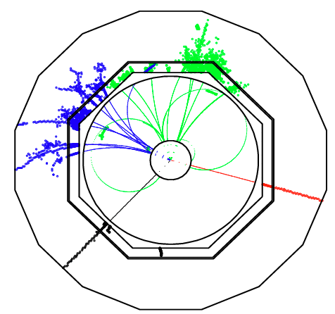
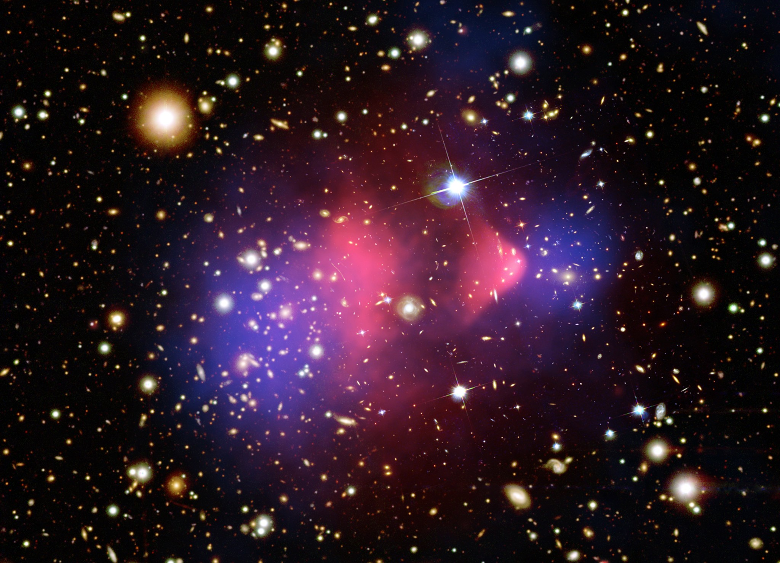
Make your own Blue Matter – In Principle and in Practice
Karlheinz Meier Kirchhoff-Institut für Physik Astronomisches Kolloquium Heidelberg 2010

Slide 2
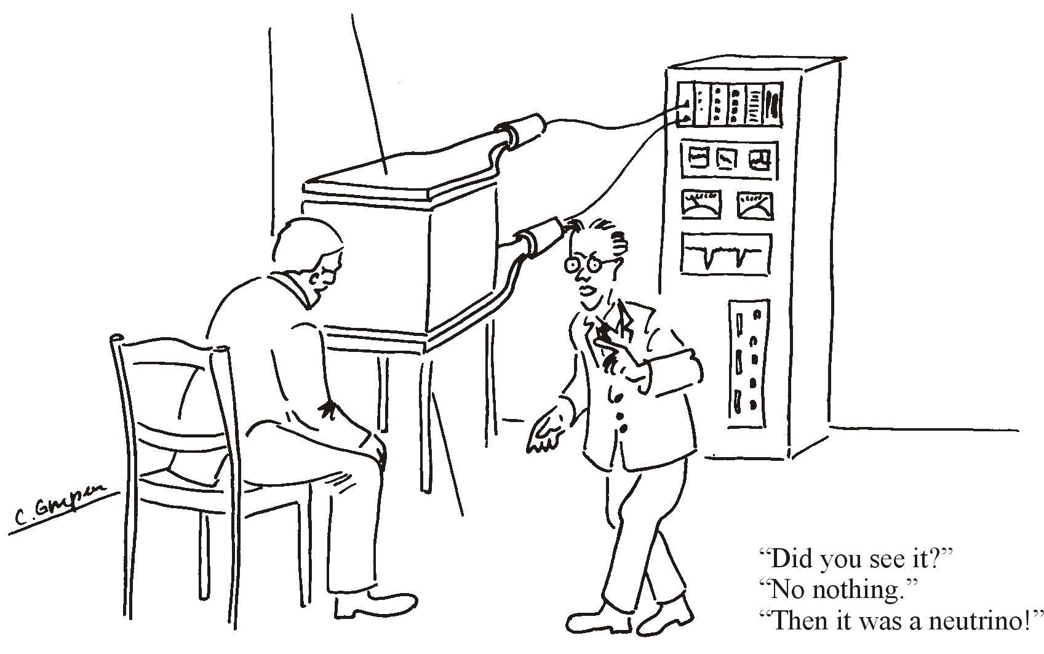
DM particle
© C. Grupen, Siegen

Slide 3
Quantitative evidence for DM from a wide range of astrophysical observations : rotation curves, CMB, lensing, colliding clusters, large scale structure
All current DM evidence is inferred from its gravitational influence
So far no convincing observations of DM non-gravitational interactions
So far no convincing evidence for DM particle nature

Slide 4
A history of cooling
Did we miss something ?

Slide 5
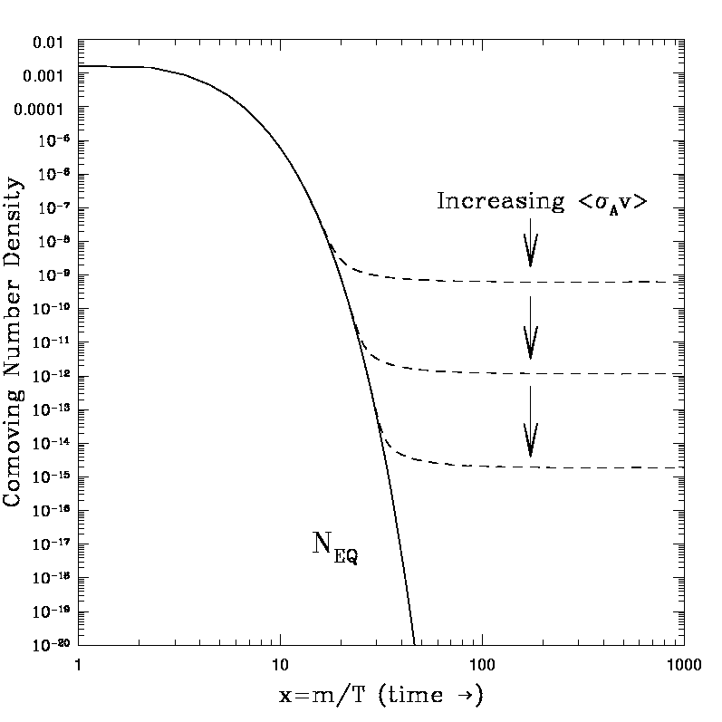
Following the thermal freeze-out process, a KNOWN, MEASURED relic density of DM is left over
Ω ~ x / <σv>
For a hypothetical particle with a 100 GeV mass this corresponds to a thermally averaged annihilation cross section of
<σv> ~ picobarn
Typical ELECTROWEAK INTERACTION cross-section
k_{B}T< mc²
k_{B}T<< mc²
Cold Dark Matter

Slide 6
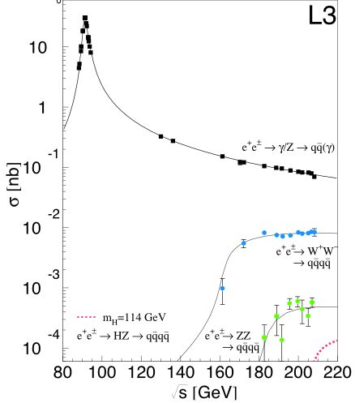
Measured electroweak pair production cross-sections (LEP at CERN)

Slide 7
Experimental Particle Physics could possibly RECREATE
Weakly Interacting Massive Particles
that are even Stable .... !

Slide 8
Axions, Neutralinos, Gravitinos, Axinos, Kaluza-Klein Photons, Kaluza-Klein Neutrinos, Heavy Fourth Generation Neutrinos, Mirror Photons, Mirror Nuclei, Stable States in Little Higgs Theories, WIMPzillas, Cryptons, Sterile Neutrinos, Sneutrinos, Light Scalars, Q-Balls, D-Matter, Brane World Dark Matter, Primordial Black Holes, …

Slide 9
What we really KNOW – From our World to the Electroweak Scale

Slide 10
DARK SIDE
KNOWN SIDE
DM Annihilation
Scattering
DM Creation, or „Make Your Own ...“

Slide 11
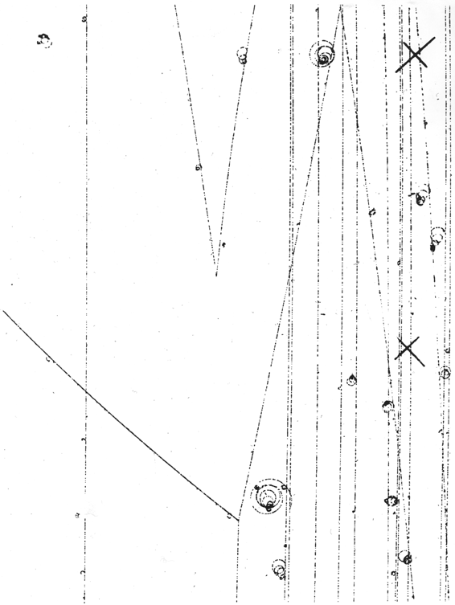
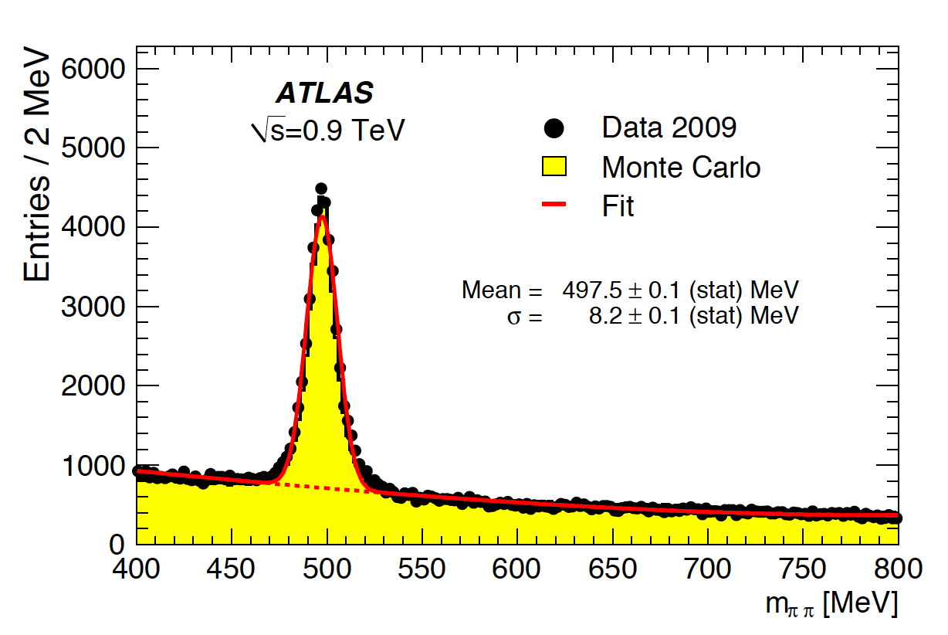
„Long-lived“, „exotic“, neutral artificially produced particles ?
A well known thing in particle physics From the 1950s to latest LHC results
.... but this one sees weak AND strong interactions, also it is not really stable ....
ATLAS Collaboration, Journal of High Energy Physics, Volume 2010, article id. #56, 2010

Slide 12
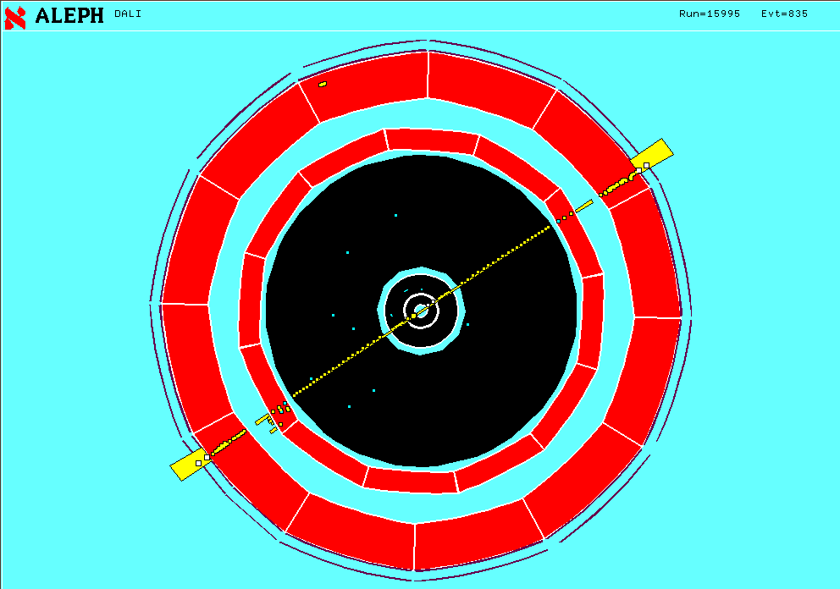
Pairwise Creation of New Matter (LEP at CERN) e⁺e⁻ -> µ⁺µ⁻
The heavier sisters of the electron (x 200)
Known since 1937 as the dominant component of „cosmic“ rays on the earths surface
Creation of a quantum number not existing at our moderate temperatures (L_{µ})

Slide 13
Particle Physics : Space - Time – Matter
Werner Heisenberg
Small Structures – Small Distances
Albert Einstein
New and Heavy Matter
Ludwig Boltzmann
High Temperatures
Temperature of the Universe drops with Time
ENERGY is the Key !

Slide 14
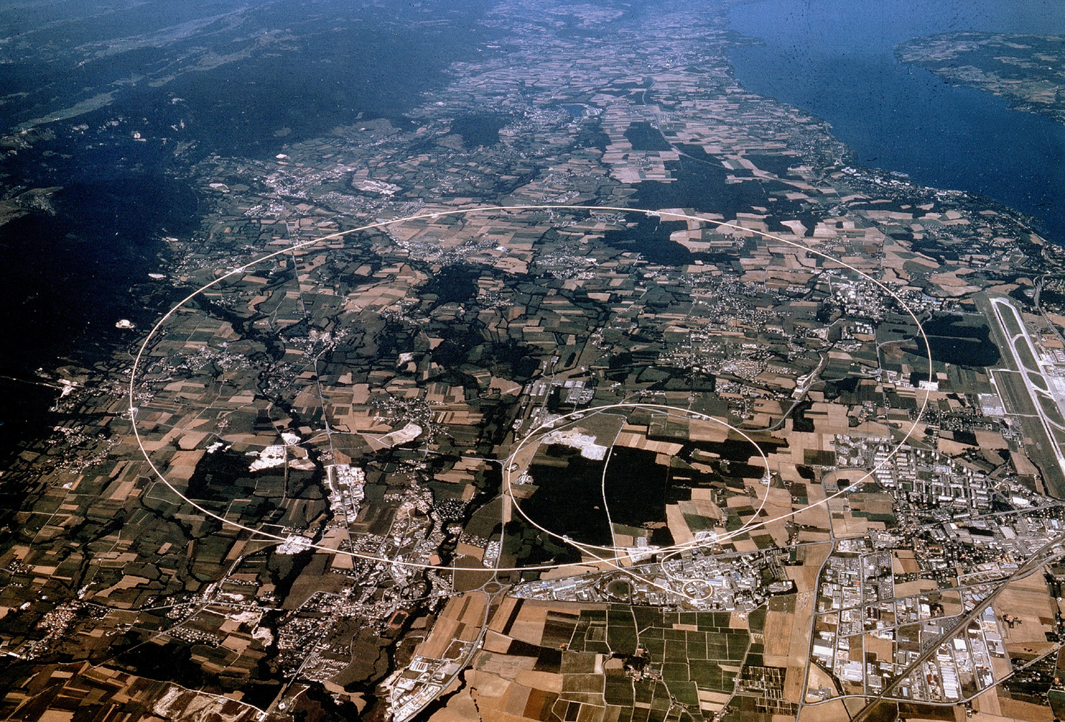
The Large Hadron Collider at CERN

Slide 15
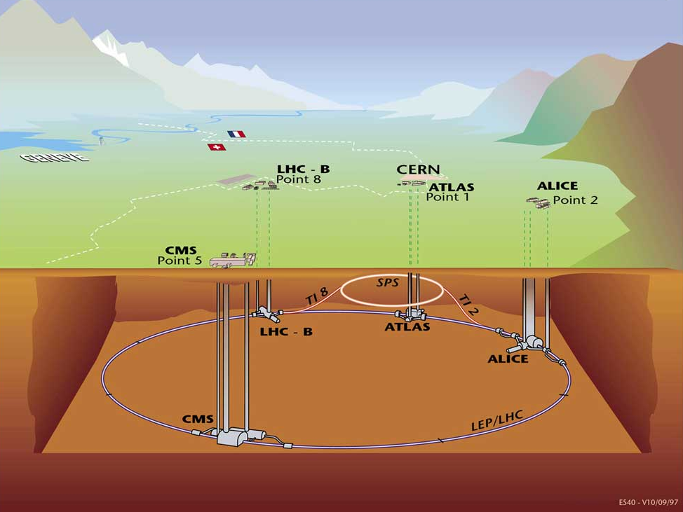
Heidelberg at the Large Hadron Collider
PI MPI-K
KIP
PI ZITI
PI
CMS
7 TeV on 7 TeV 3.5 TeV on 3.5 TeV

Slide 16
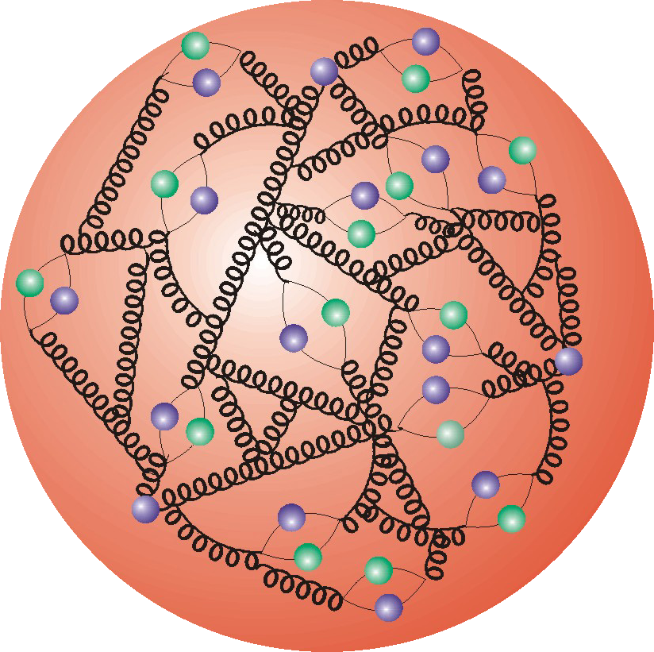
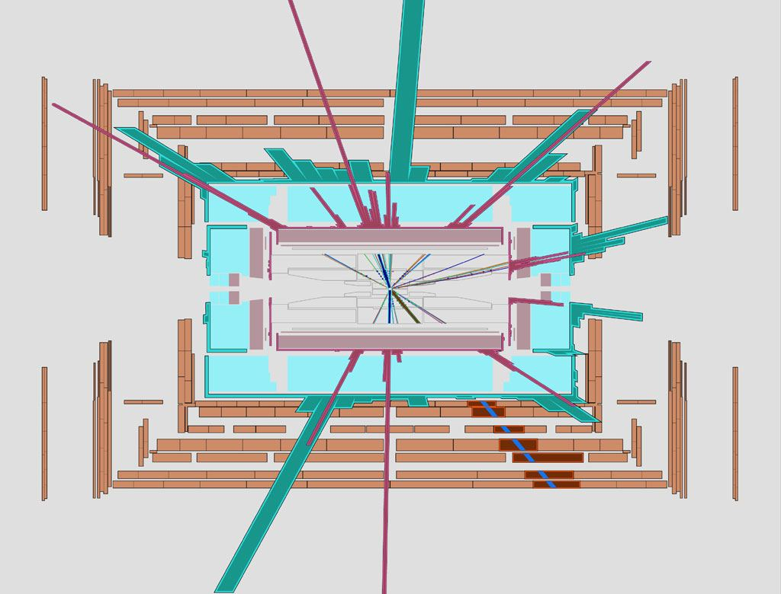
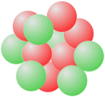
2 times 7 = 14 ?
Two avenues towards LHC physics :
1 TeV in collisions of „partons“ in the proton (THE TERASCALE)
5.5 TeV in collisions of nucleons in lead nuclei

Slide 17
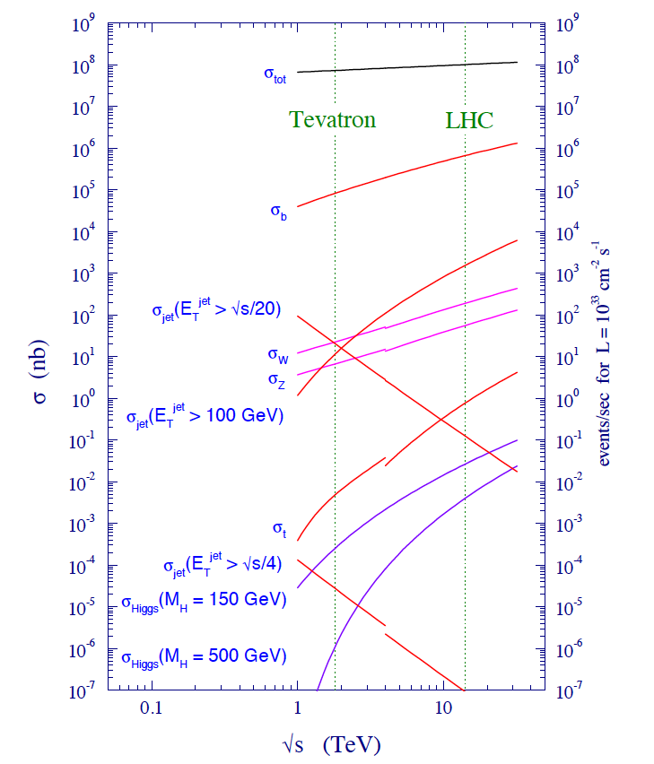
LHC :
The Cross-Section Challenge
Task :
- Check everything
- Select the RARE

Slide 18
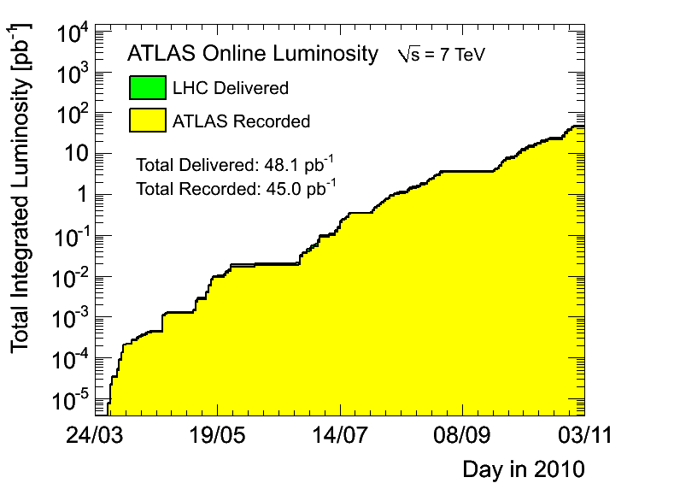

Slide 19
Collision products are recorded
by surrounding detector.
The detector should:
have large coverage
(catch most particles)
be precise
be fast
Each meeting of two bunches results
in about 23 proton-proton collisions.
Average number of particles created
in such collisions is about 1500.
10¹¹ protons
in each bunch
Each proton carries energy 7 TeV (now 3.5 TeV)
Each bunch with 10¹¹ protons carries an energy
of 10¹¹×7×10¹² eV = 7×10²³ eV = 44 kJ.
This is a macroscopic !
Corresponds to a bike at 30 km/h …

Slide 20
The strategy of a detector : To catch almost all particles:
Magnetic field bends tracks and
helps to measure momenta of particles.
electron
Hadronic calorimeter:
Material for
hadronic shower,
measures deposited energy.
muon
hadrons
Tracker: Not much material,
finely segmented detectors
measure precise positions
of points on tracks.
Electromagnetic calorimeter:
Material for electro-
magnetic shower, measures
deposited energy.
Muon detector:
Measures muon tracks.

Slide 21
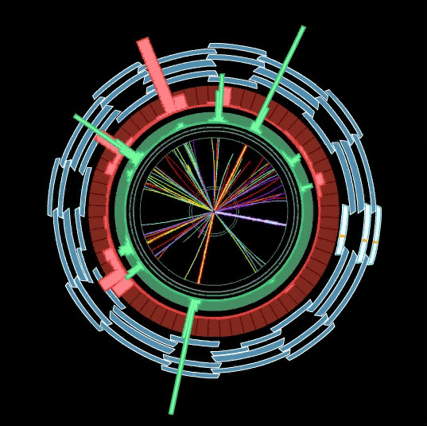
Detectors are wrapped around the beam pipe and the collision point –
A schematic and less schematic cut through the ATLAS detector
The Tracker or Inner detector
The Electromagnetic calorimeter
The Hadronic calorimeter
The Muon detector

Slide 22
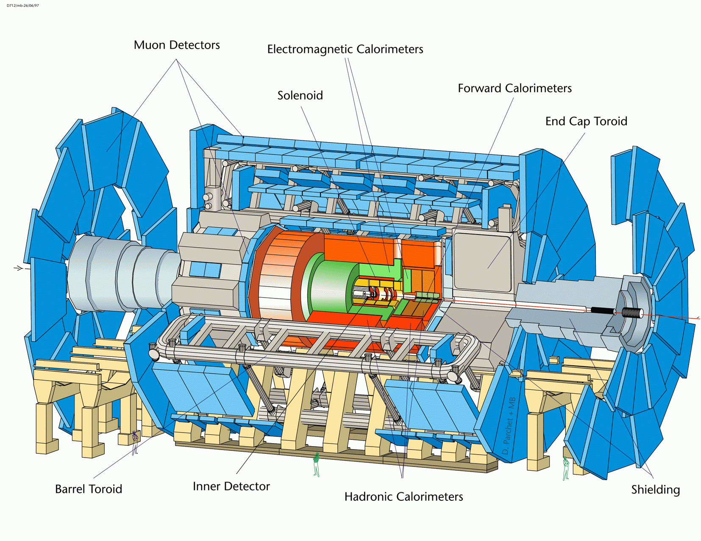
ATLAS
22 m
44 m

Slide 23
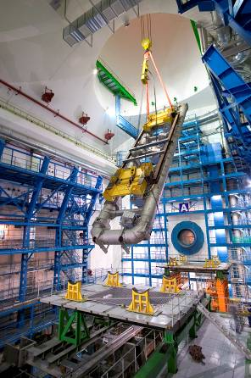
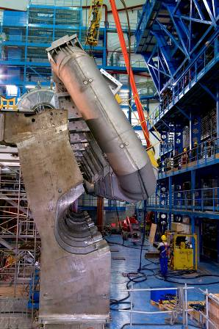
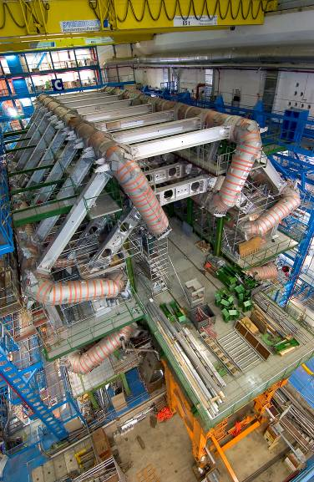
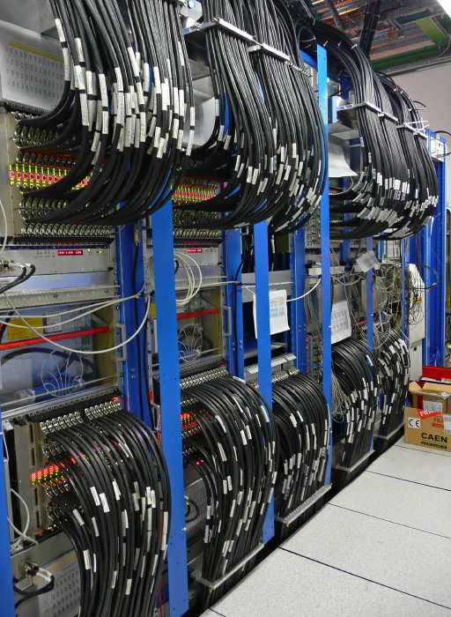
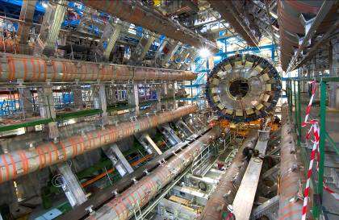
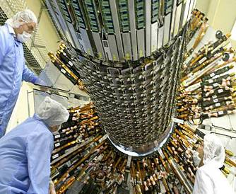

Slide 26
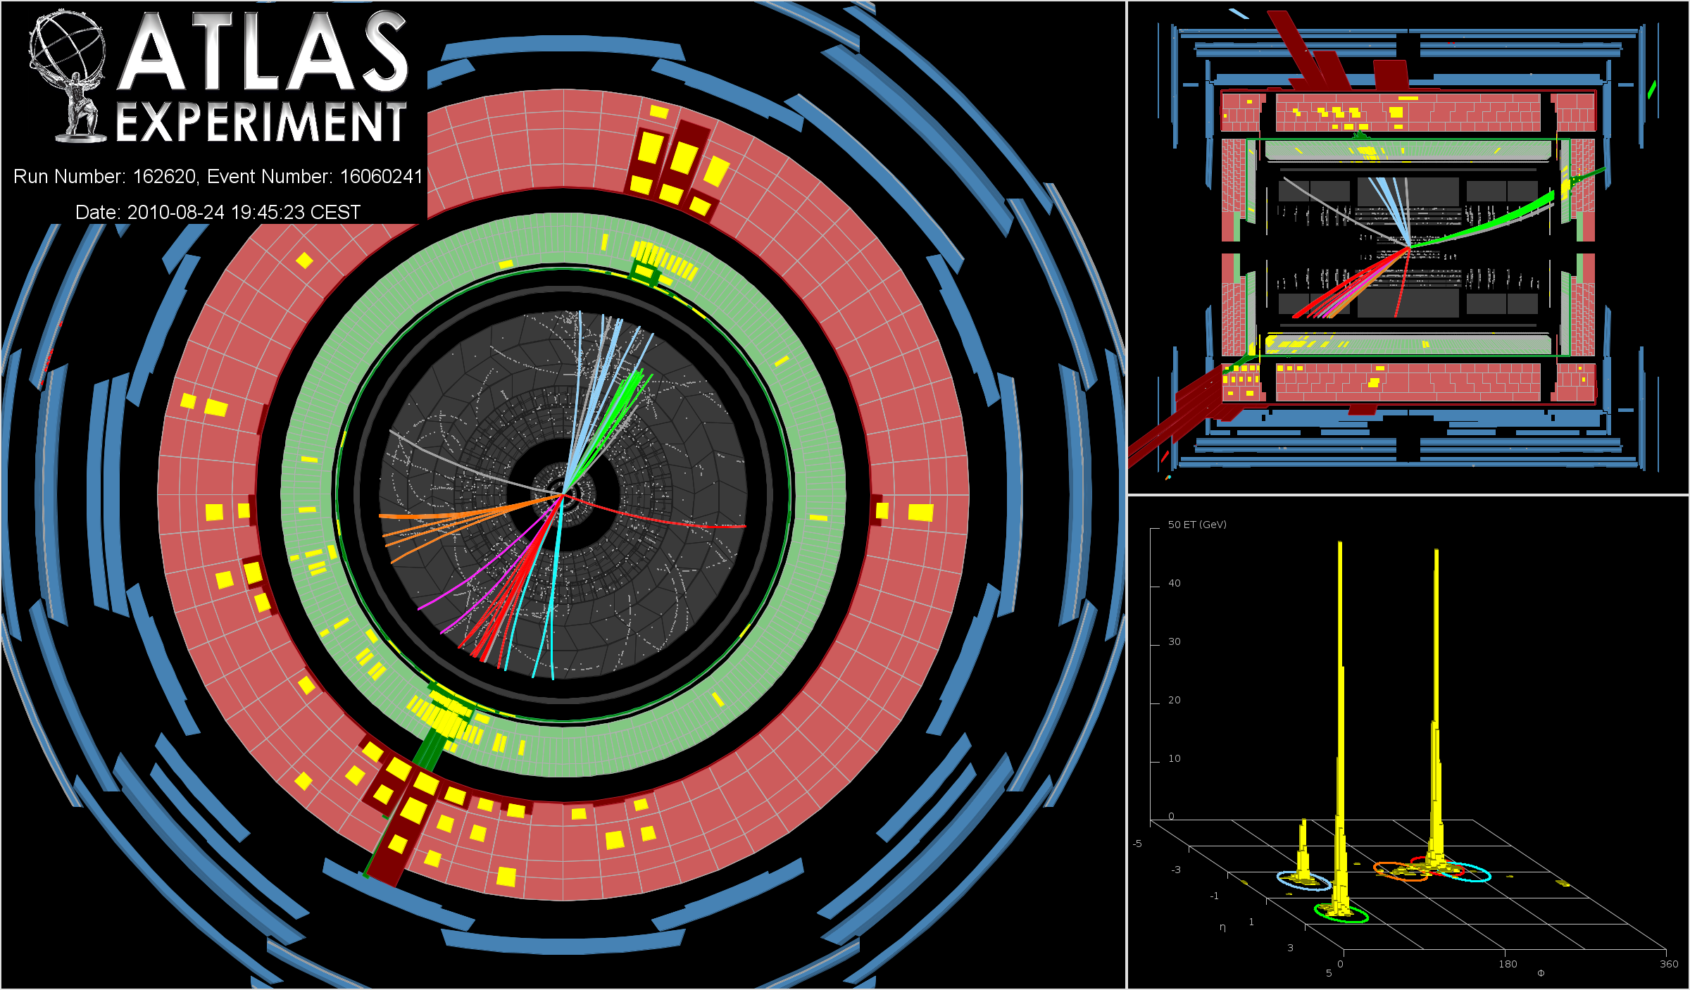

Slide 27
„Missing E_{T}“ (MET)

Slide 28
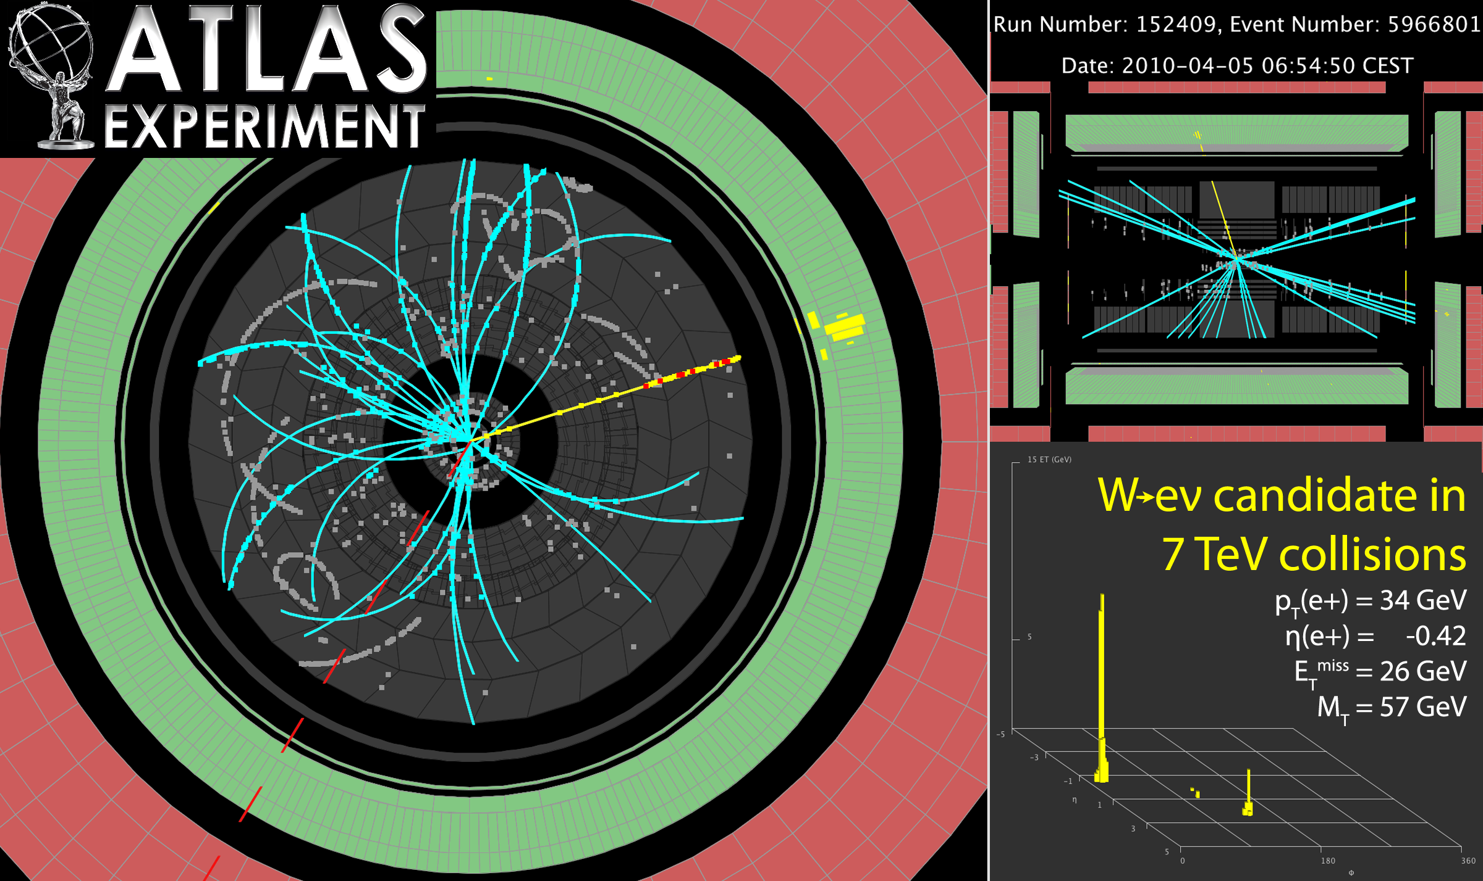

Slide 29
A historical problem : E=mc² for the electron
Electron size < 10⁻¹⁸ cm !
Electron repels itself
Need at least 10¹⁰ eV of energy to pack electric charge tightly inside the electron
But the observed mass of the electron is only 5×10⁵ eV
Electron cannot be smaller than 10^{–13} cm ?
Breakdown of theory of electromagnetism

Slide 30
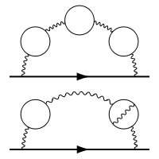
New Anti-Matter helps - QED
Loops of matter anti-matter creation/annihilation
Electron annihilates the positron in the bubble
⇒ reduction of mass

Slide 31
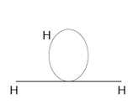
Higgs repels itself, too
Just like the electron repelling itself because of its charge, the Higgs boson also repels itself
Requires a lot of energy to contain itself in its point-like size!
Breakdown of theory of weak force

Slide 32
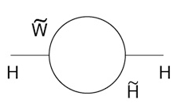
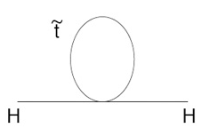
Play the same trick again ?
Known particle loops (100 GeV)² = (10¹⁶ GeV)²  (10¹⁶ GeV)²
Double particles : superpartners
Loops of superpartners cancel the energy required to contain Higgs boson in itself

Slide 33
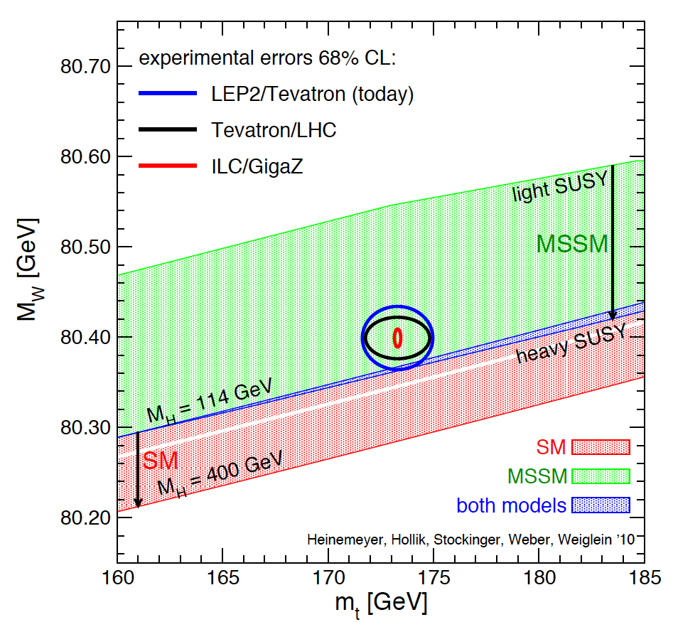
The Billion Dollar Plot

Slide 34
Supersymmetry gives rise to partners of known standard model states with opposite spin-statistic (Fermion – Boson)
~
~
~
~
Bosons
~
~
~
~
h
A
H⁰
H±
χ⁰₁
χ⁰₂
χ⁰₃
χ⁰₄
H⁰_{u}
H⁰_{d}
H⁺_{u}
H⁻_{d}
Fermions
~
~
~
~
u
d
e
ν_{e}
u
d
e
ν_{e}
Fermions
~
~
~
~
c
s
μ
ν_{μ}
c
s
μ
ν_{μ}
Bosons
~
~
~
~
t
b
τ
ν_{τ}
t
b
τ
ν_{τ}
~
~
~
~
~
γ
Z
W±
χ ± ₁
χ ± ₂
Bosons
γ
Z
W±
~
Fermions
g
g
Bosons
~
G
G
Fermion
Particles Sparticles

Slide 35
~
~
~
~
~
~
~
~
χ⁰₁
Minimal SSM (1)
2 complex Higgs-doublets 8 free scalar parameters 5 physical Higgs fields:
H± H₁⁰ H₂⁰ A⁰
h
A
H⁰
H±
H⁰_{u}
χ⁰₂
χ⁰₃
χ⁰₄
H⁰_{d}
H⁺_{u}
H⁻_{d}
~
~
~
~
u
d
e
ν_{e}
u
d
e
ν_{e}
~
~
~
~
c
s
μ
ν_{μ}
c
s
μ
ν_{μ}
~
~
~
~
t
b
τ
ν_{τ}
t
b
τ
ν_{τ}
~
~
~
~
~
γ
Z
W±
χ ± ₁
χ ± ₂
γ
Z
W±
~
g
g
~
G
G

Slide 36
~
~
~
~
Minimal SSM (2)
Gauginos mix with higgsinos and therefore result in
4 charginos and 4 neutralinos !
~
~
~
~
h
A
H⁰
H±
χ⁰₁
χ⁰₂
χ⁰₃
χ⁰₄
H⁰_{u}
H⁰_{d}
H⁺_{u}
H⁻_{d}
~
~
~
~
u
d
e
ν_{e}
u
d
e
ν_{e}
~
~
~
~
c
s
μ
ν_{μ}
c
s
μ
ν_{μ}
~
~
~
~
t
b
τ
ν_{τ}
t
b
τ
ν_{τ}
~
~
~
~
~
γ
Z
W±
χ ± ₁
χ ± ₂
γ
Z
W±
~
g
g
~
G
G

Slide 37
124 FREE PARAMETERS for masses and couplings !!
Possibly conservation of R parity:
R = (-1) ^{2S –L + 3B}
S = spin, L = lepton number, B = baryon number
Particles have R = +1, sparticles R = -1:
Sparticles produced in pairs
Heavier sparticles → lighter sparticles
Lightest supersymmetric particle (LSP) stable, candidate for particle interpretation of CDM

Slide 38
From CDM to Supersymmetry
Non-baryonic matter density obtained from WMAP measurements:
0.094 < Ω_{DM} h² < 0.129
For any specific set of parameters of a supersymmetric R-parity conserving model, it is possible to compute the corresponding LSP relic density from the mass spectrum and the Big-Bang cosmology.
The relic density should be less than Ω_{DM} (if other contributions to the DM).
The WMAP measurement is a constraint that defines cosmologically interesting
regions of the SUSY parameter space.
… and back to CDM
Once (if ever …) we will have a measurement of the mass mass spectrum and the mixing angles, we can compute the relic density it corresponds to.

Slide 39
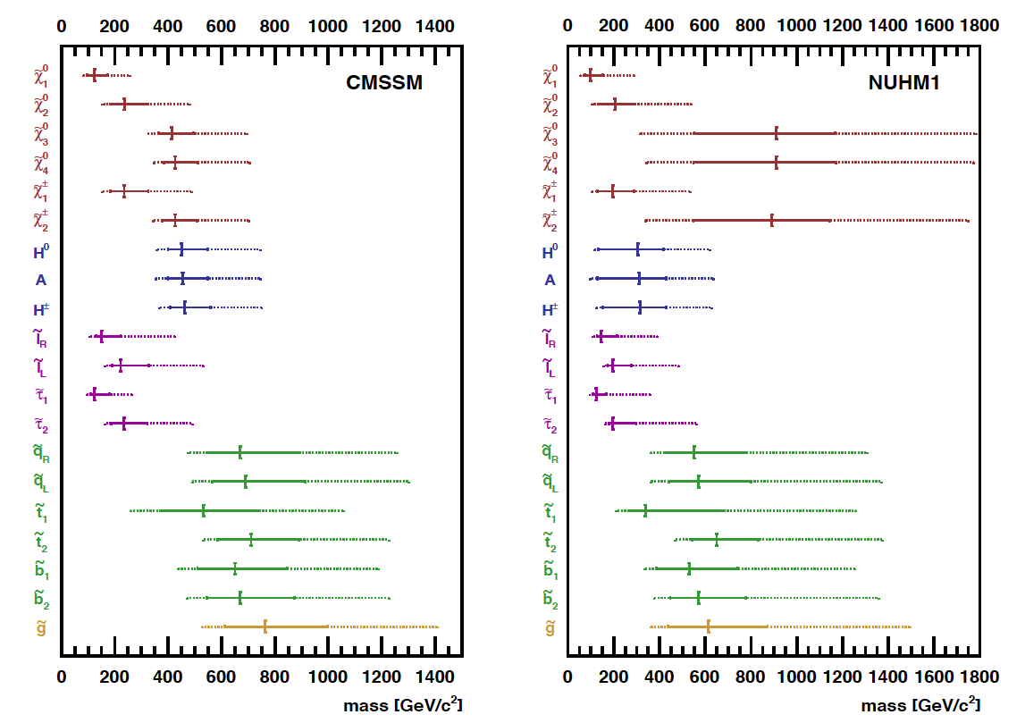
Making the best (?) of theory, electroweak HEP data and cosmology .....
S. Heinemeyer and G. Weiglein, Nuclear Physics B, Volume 205, p. 283-288, 2010

Slide 40
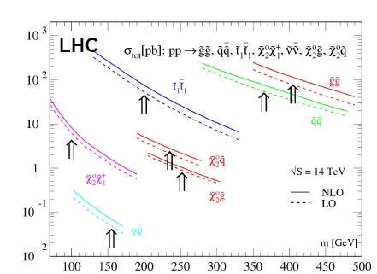
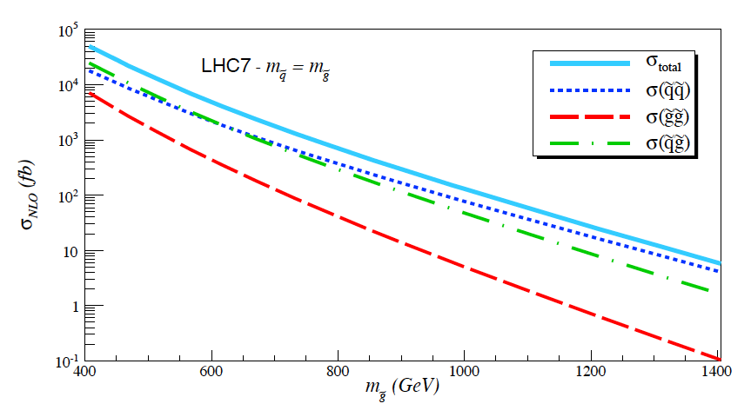
SUSY Production at the LHC
Weak for light Strong for heavy (and light ..) Strong for the beginning
Strong for less !
H.Baer et al., Capability of LHC to discover supersymmetry with sqrt {s} = 7{text{TeV}} and 1 fb^{‑1}, Journal of High Energy Physics, Volume 2010, article id. #102

Slide 41
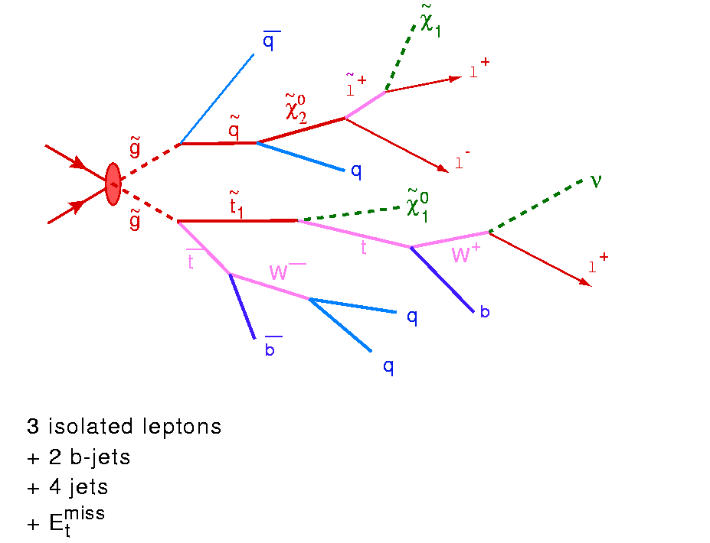
The LHC likes strong interactions !
Quarks and gluons in the initial state
Squarks and gluinos are the objects to produce !
The last in the cascade (The NEUTRALINO) might be 23% of our universe ...

Slide 42
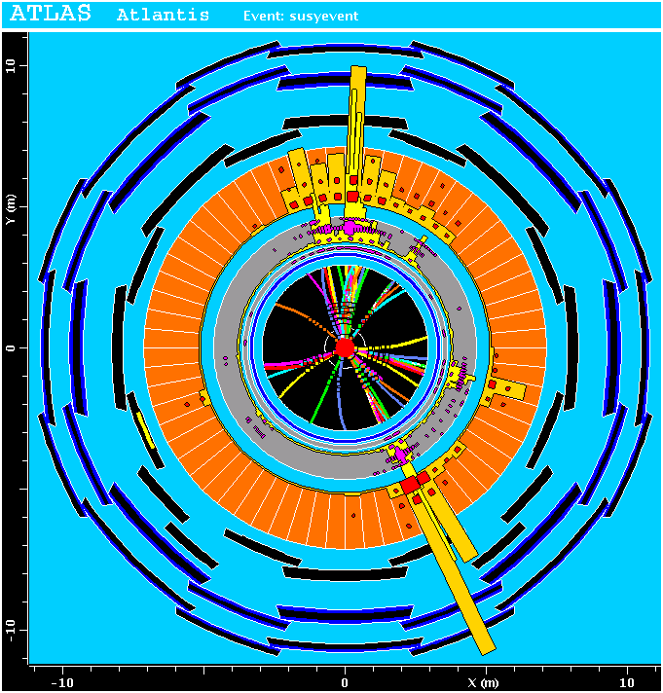
~
χ⁰₁
MET
~
χ⁰₁

Slide 43
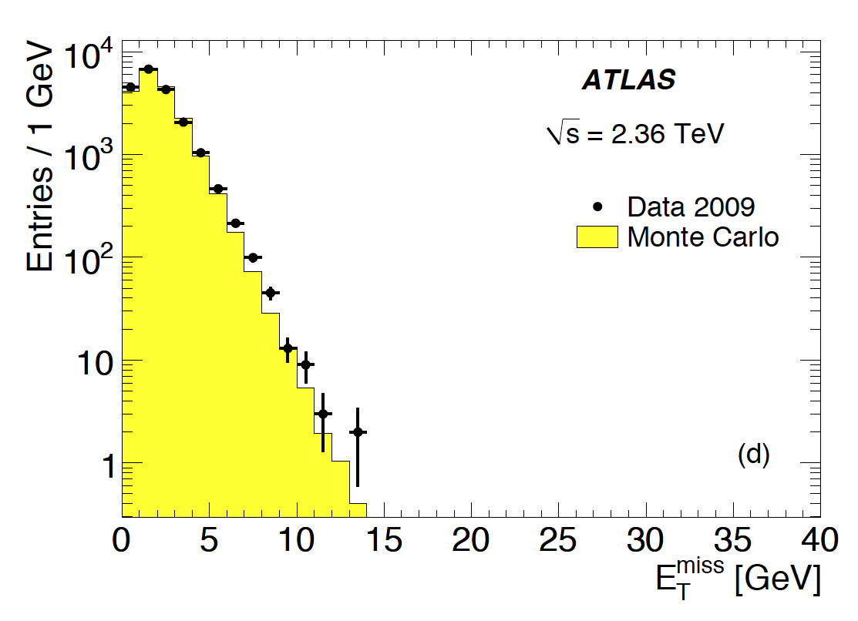
ATLAS Collaboration, Journal of High Energy Physics, Volume 2010, article id. #56, 2010

Slide 44
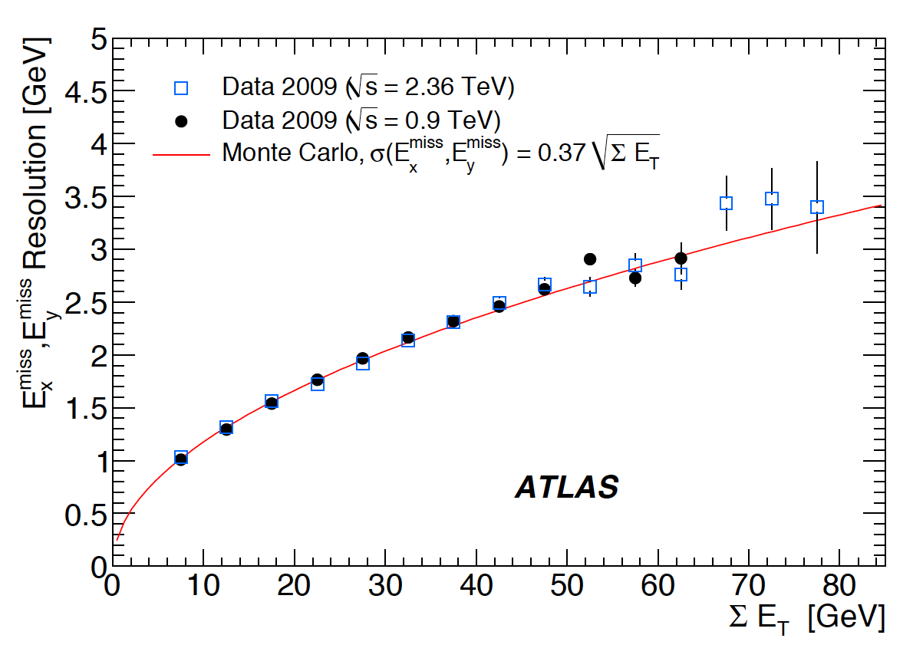
ATLAS Collaboration, Journal of High Energy Physics, Volume 2010, article id. #56, 2010

Slide 45
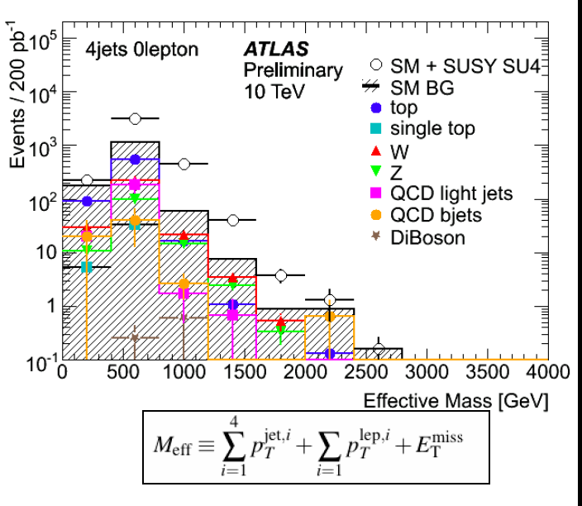
But when it comes to RARE topologies there will be COMPETITION !
SIMULATED Example : M_{squark} = M_{gluiono} = 410 GeV
Can you spot the signal ?

Slide 46
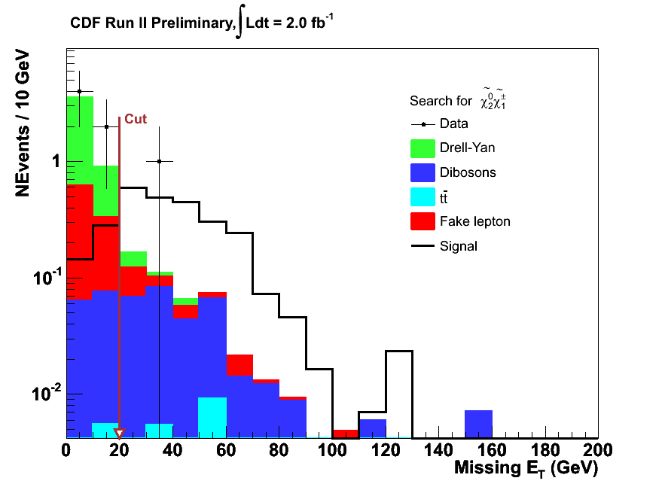
m₀=60, m_{½}=190, tan(beta)=3, A₀=0, sign(mu)>0

Slide 47
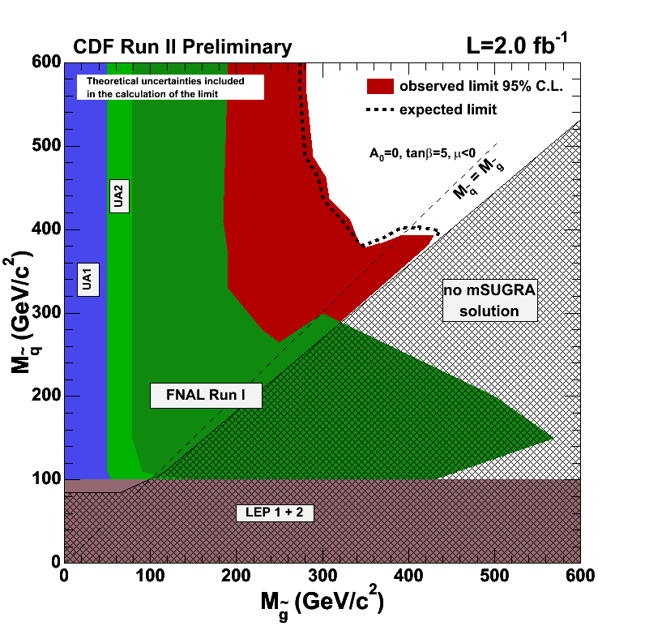
CDF Collaboration, PRL 102, 121801 (2009)

Slide 48
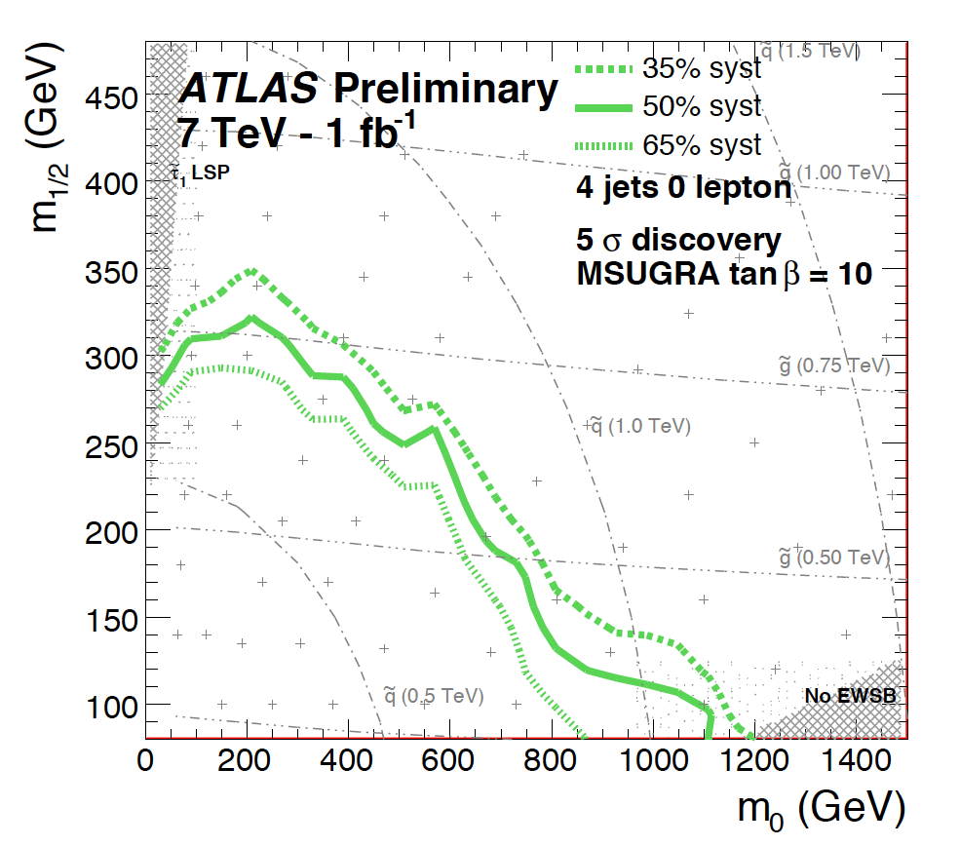
UNIVERSAL GAUGINO
UNIVERSAL SCALAR
ATLAS Collaboration, http://cdsweb.cern.ch/record/1278474/files/ATL-PHYS-PUB-2010-010.pdf

Slide 49
„Physics has been exceptionally successful in uncovering
fundamental laws of nature. Such laws are typically formulated on characteristic length or distance scales, on which specific interactions between few components can be isolated experimentally and theoretically. These length scales are microscopic in comparison to the corresponding scales of emergent macroscopic features of the complex structure formed by the microscopic constituents. Once the microscopic laws are identified, understanding the emergence of complexity in the macroscopic world is one of the major challenges of modern Physics“
Heidelberg in the Autumn of 2010

Slide 50
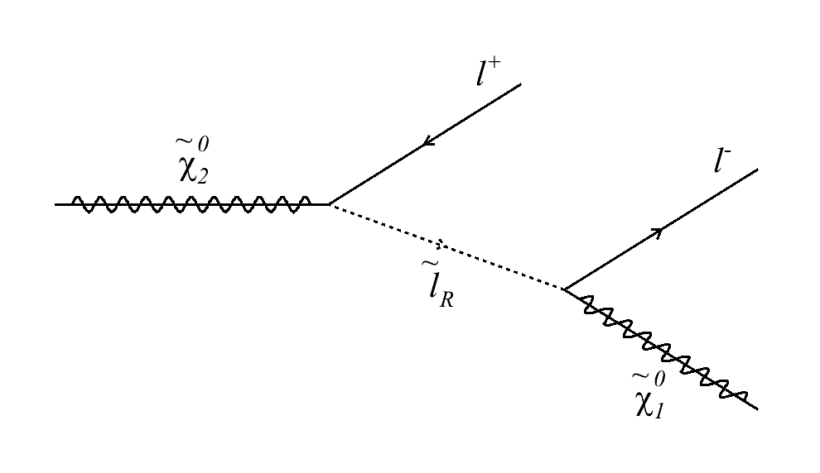
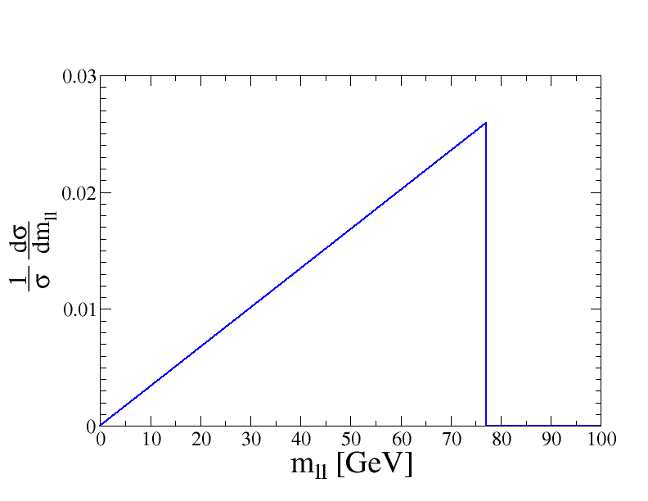
Exclusive Reconstruction of Supersymmetric Particle Masses
e.g. consider the decay
angle between leptons
m_{ll} is maximised when leptons are back-to-back in slepton rest frame

