Slide 1
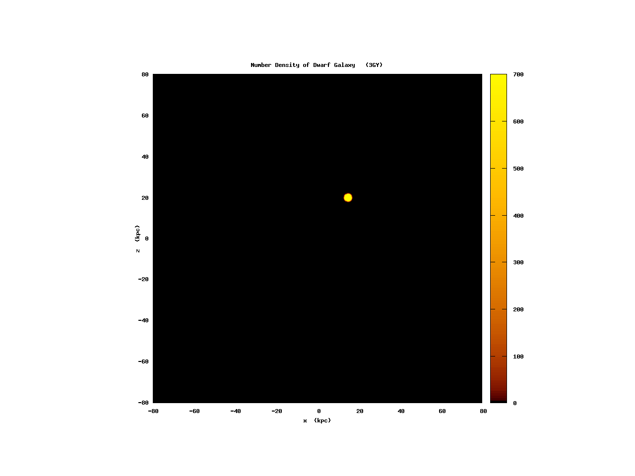
Small Scale Structure in the Galaxy
Alice Quillen (University of Rochester)
movie by Justin Comparetta
Notes:
List of movies: hist_03_sat.mov

Slide 2
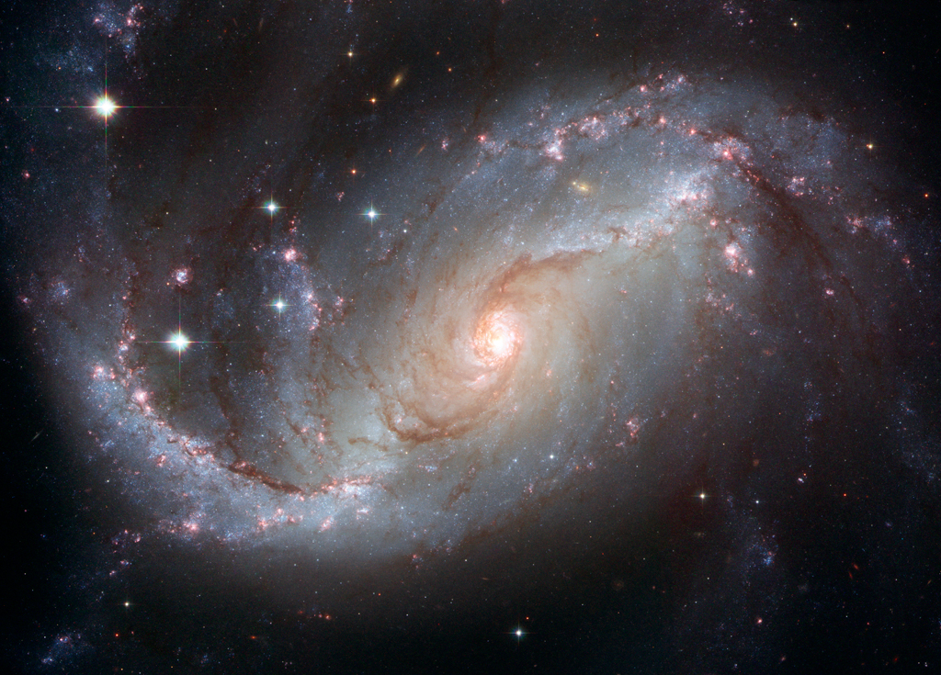
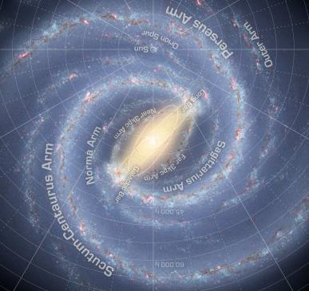
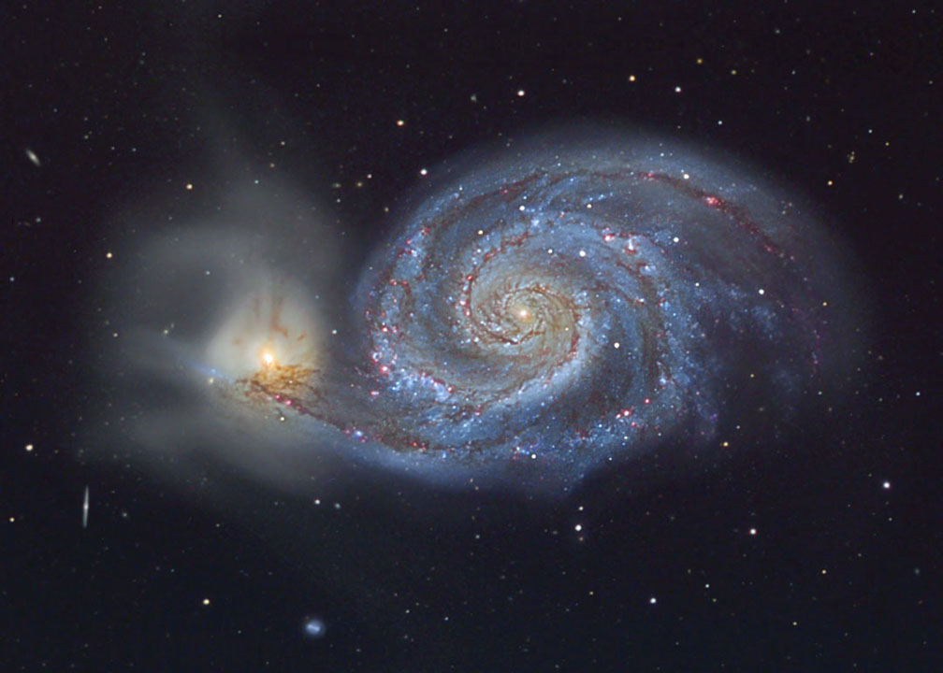
Morphology of the Milky Way
Distances uncertain. Projection is difficult.
Cartoons favor 2 or 4 armed symmetrical structures because they are assumed. Dominant constrains are the tangents

Slide 3
Burkhard Fuchs test particle simulations have primarily explored steady state spiral models. What is the signature of a transient or varying spiral wave?

Slide 4
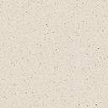
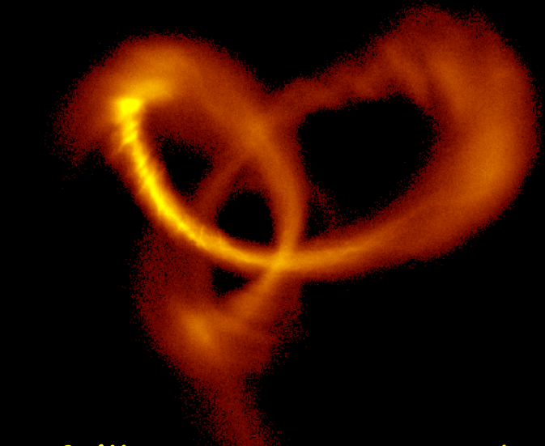
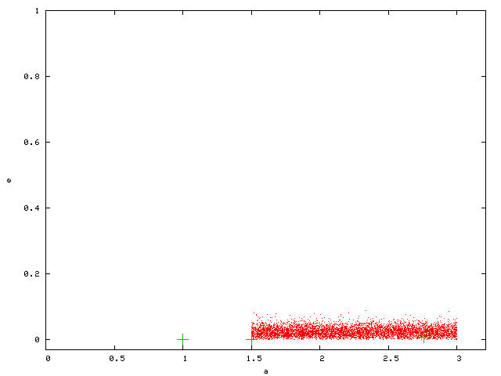
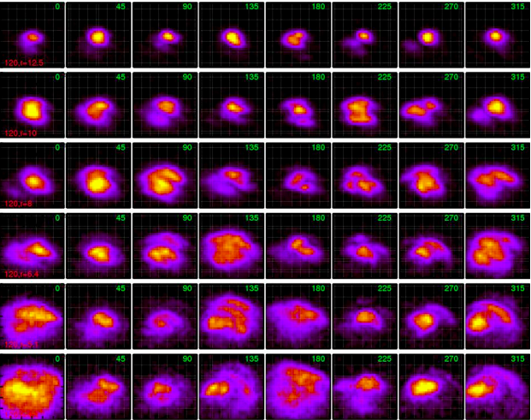
Integrating many particles on a GPU
Test particle simulations
Direct N-body simulations with tracers
QYMSYM
Collaborators :
  Justin Comparetta
  Alex Moore (QYMSYM)
  Ivan Minchev (migration, resonant heating)
  Michaela Bagley, Jamie Dougherty
  Richard Edgar (sneth.pas.rochester.edu)

Slide 5
Challenges
Uncertainty in mechanisms
Spiral structures: modal or transient or coupled?
Migration, mixing and heating, dependence on time and position, how much due to mergers vs spiral/bar
Star formation: wave driven vs localized bursts
Lopsided and warped outer Galaxy (common but possibly important), role of mergers in triggering spiral structure and affective heating and mixing
To explain and understand
Lack of strong correlation between metallicity and kinematics in disk-- Large metallicity scatter in disk
Structure in velocity fields
Nature of spiral structure in our Galaxy (patterns, number of arms, lifetimes) -- lack of consensus

Slide 6
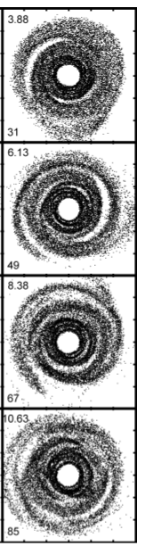
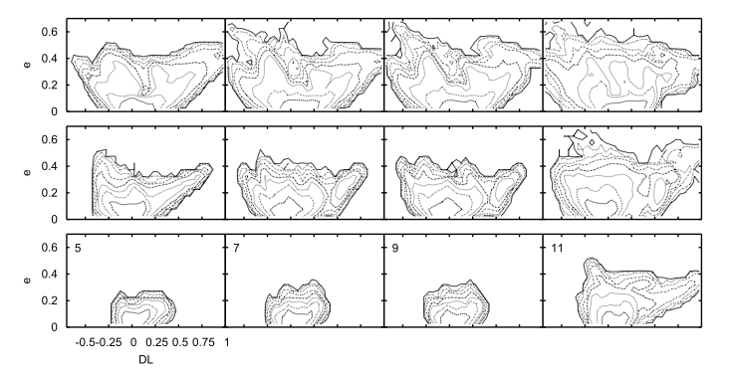
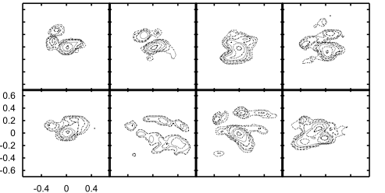
Disk perturbed by a low mass satellite passing through the disk
Migration
earlier later
Outer disk
Mid disk
eccentricity
Inner disk
velocity distributions
10⁶ particles
change in mean radius
each panel is a different timestep
v
10⁵ particles
10⁷ particles
u
Induced over short timescales: heating, migration, extended disk, warping, lopsidedness, streams

Slide 7
Two topics
Galactic disk, Milky Way model
  Goal: understand Milky Way disk structure from local velocity distributions observed in forthcoming large surveys. Interpret abundances in terms of formation and evolution (chemical tagging)
2) Tidal tails, e.g., disruption of Sagittarius dwarf
  Goal: Constraints on CDM, dark matter sub-halo distribution from tidal tail substructure
  Most previous work on disk velocity distributions done with test particle simulations
  Most previous work on tidal tails from disrupted dwarf galaxies use limited numbers of particles in the tail

Slide 8
Numerical details
  Hybrid N-body, massive + tracer particles. For disk: running 1 million massive particle + 3 million tracer. Self-consistent N-body with extra particles to resolve substructure. Smoothing length 10pc, force resolution not quite good enough.
  Modified Phi-grape (Harfst et al. 09) with Sapporo GPU replacement for Grape (Gaburov et al. 09).
  using GalacticICS for initial conditions (Widrow and Dubinski 05) Milky Way model satisfies a suite of observational constraints to match current Milky Way
  Halo is live but under-resolved.

Slide 9
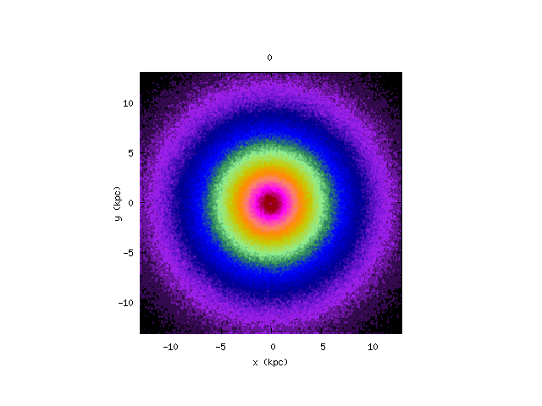
Michaela’s simulations
Only disk particles are shown.
Halo is live, center of bulge moves
Center of mass remains within a smoothing length throughout simulation
Notes:
movie: d_anim_extend.mov

Slide 10
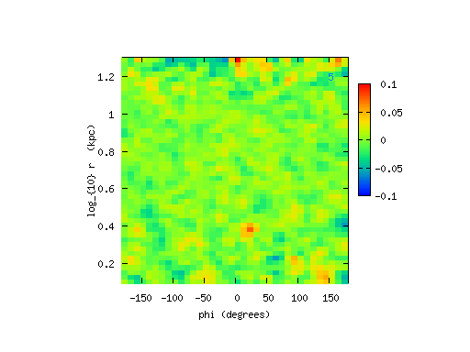
In polar coordinates
logarithmic spirals on top are slower than bar on the bottom
Constructive and destructive interference between patterns
Notes:
movie: rm_movie_small.mov

Slide 11
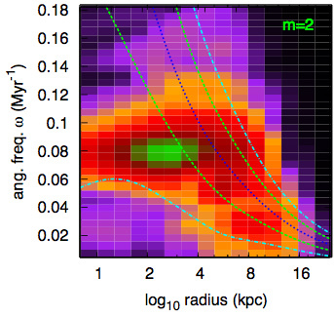
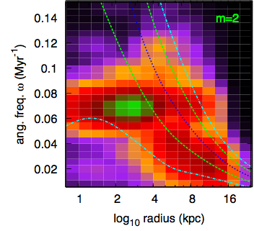
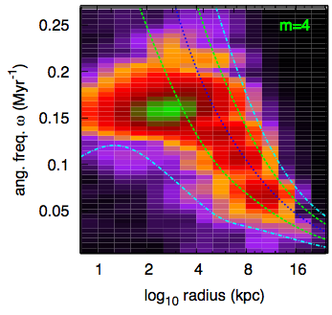
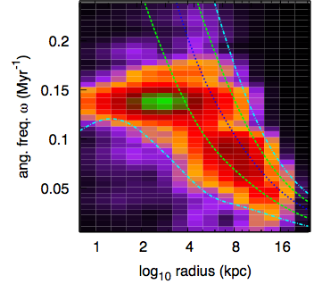
Spectrograms mid and late simulation
Bar is slowing down. Similarity of spectrograms at different times during simulation implies that waves are coupled.

Slide 12
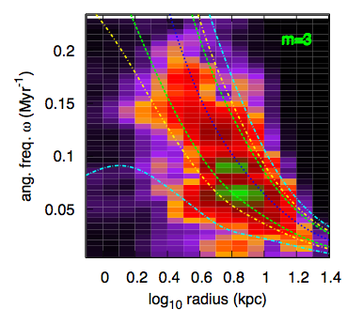
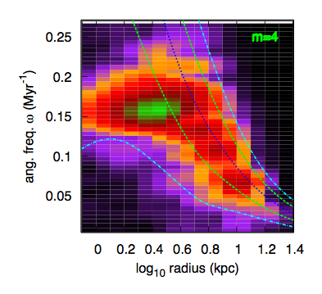
Wave coupling
A resonance of one wave may be coincident with a resonance of another wave

Slide 13
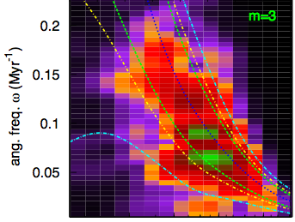
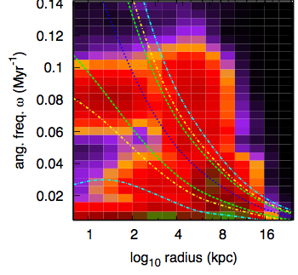
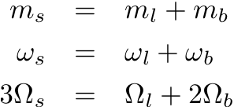
Three-armed wave
Non-linear Wave coupling
Bar and slow lopsided structure, likely coupled to three-armed waves
Sygnet et al. 88
Tagger et al. 97
Masset & Tagget 87
Rautiainen et al. 99

Slide 14
Models for spiral structure
We had been expecting:
  modes, long lived (Lin-Shu)
  transient, stochastic waves (Toomre, Elmegreen, Sellwood)
What we might be seeing:
  coupled (via non-linear terms) waves (Tagger, Masset)

Slide 15
Jamie’s local velocity distributions
u
r₀=12.5
v
r₀=10
r₀=8
radius
r₀=6.4
r₀=5.1
r₀=4.1
angle w.r.t. bar

Slide 16
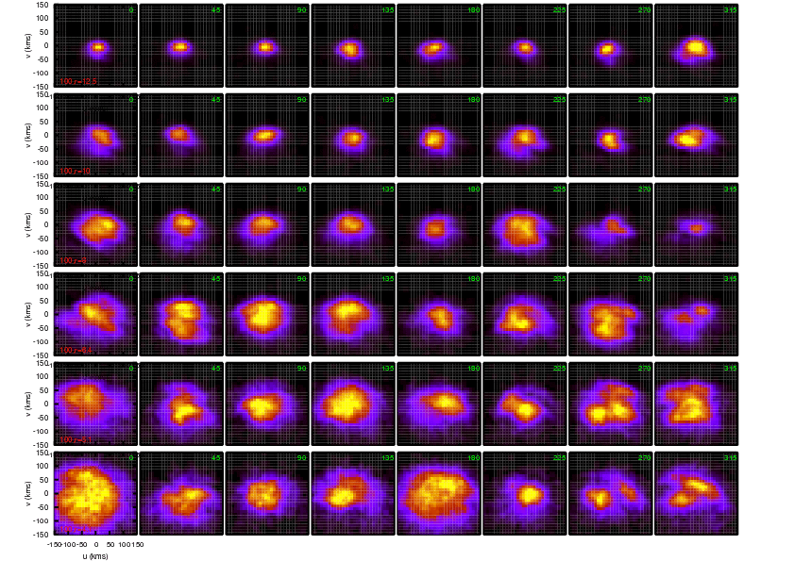
As a function of time
Notes:
movie: page.mov

Slide 17


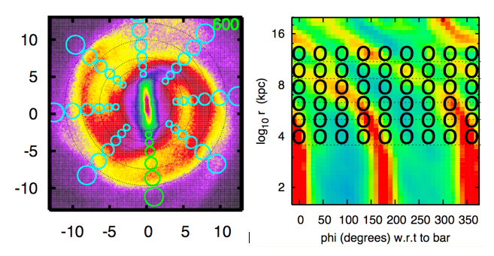
Local neighborhoods

Slide 18
Comments on the local velocity distributions
Low dispersion interarm
Higher dispersions and arcs on arm peaks
Gaps, arcs and clumps everywhere in the galaxy
Gaps from bordering neighborhoods tend to be at shifted v velocities.
v sets angular momentum so mean orbital radius

Slide 19
uv plane vs orbital elements
mean radius r_{g}
epicyclic angle θ
v tangential
epicyclic amplitude
u (km/s) radial

Slide 20
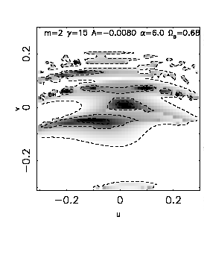
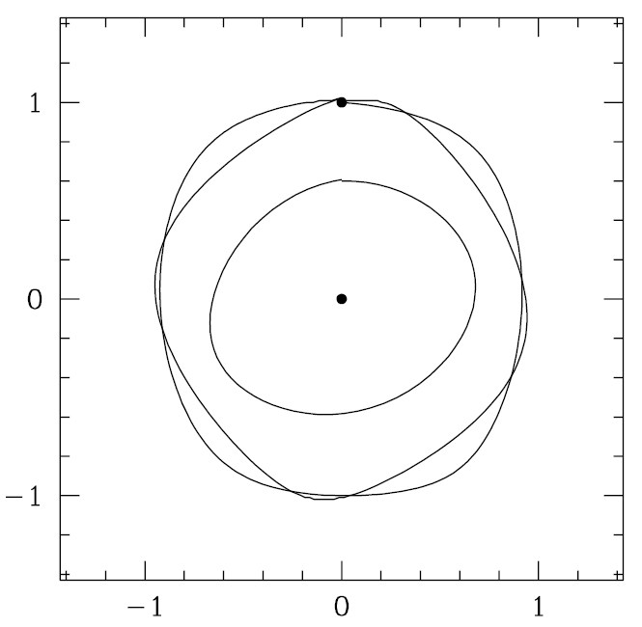
We had expected resonances to account for gaps in velocity distribution
v →
u →
Near the 4:1 Lindblad resonance. Each region on the u,v plane corresponds to a different family of closed/periodic orbits
No nearly circular orbits exist near resonance so there is a gap in velocity distribution

Slide 21
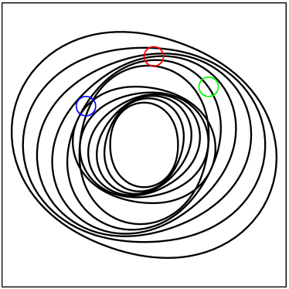



Discontinuities in spiral structure
relation between orientation and velocity distribution

Slide 22
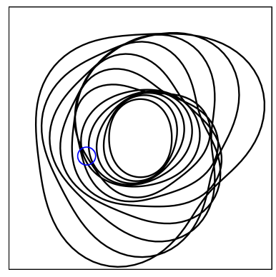
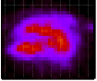
Discontinuities in spiral structure when multiple waves are present
Armlets
Kinks or bends in spiral arms
Manifest in velocity distributions as gaps
2 armed inner + 3 armed outer pattern

Slide 23
Deviations from symmetry in two armed structure can be predicted with addition of an additional 3 armed structure, that at different times gives armlets

Slide 24
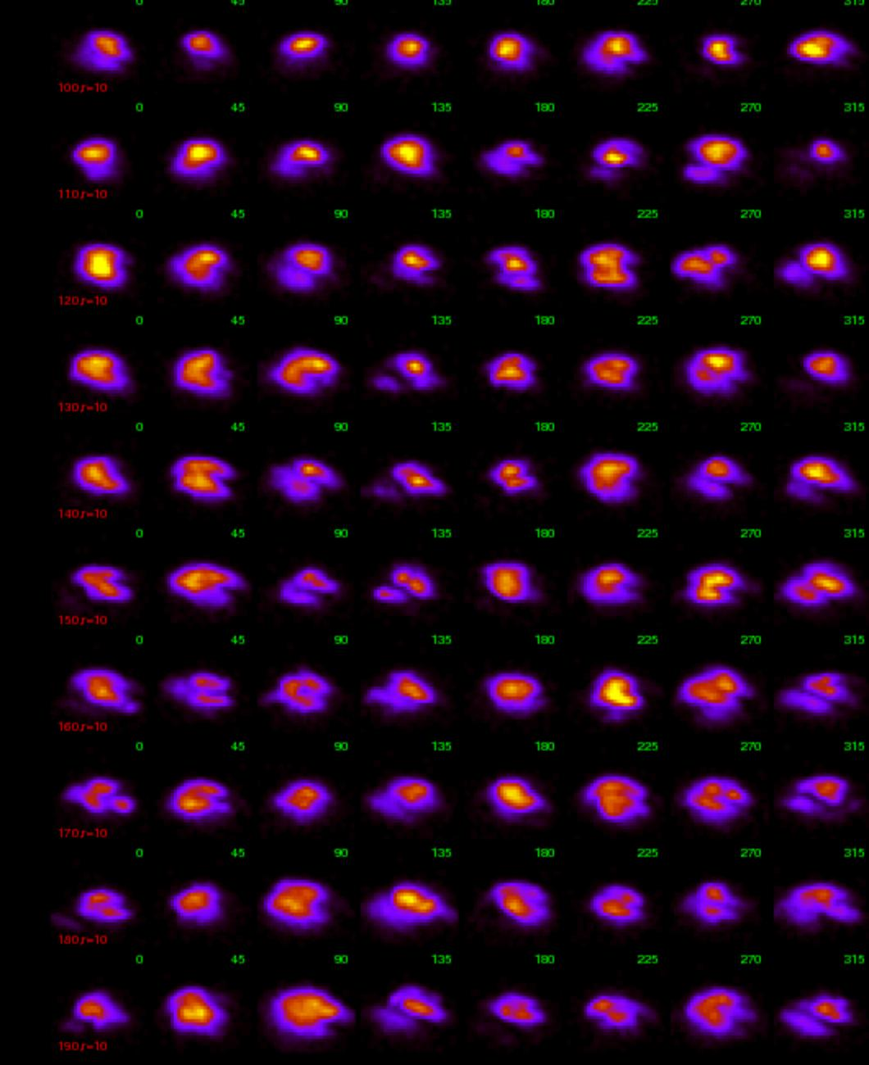
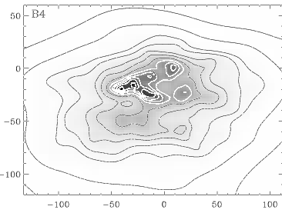
Hercules stream- like structure near bar’s Outer Lindblad Resonance
Hipparcos velocity distribution Dehnen 98
time
Hercules stream
angle w.r.t. bar

Slide 25



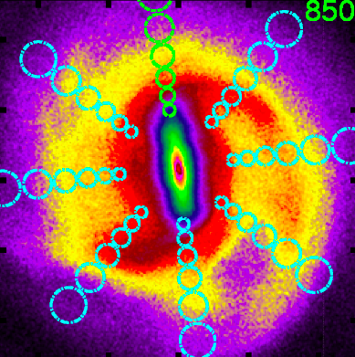
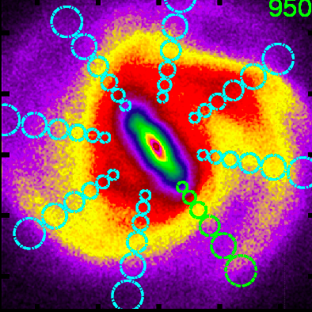
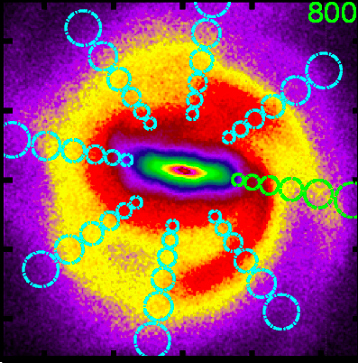
Like the solar neighborhood
velocity distributions at different times
Hipparcos velocity distribution
Bob Hurt’s cartoon

Slide 26
Interpretation of our Galaxy
Biased view of the disk velocity distribution due to our inter-arm location in Galaxy (on arm peaks the velocity dispersion higher and there are gaps)
Lack of consensus of local spiral pattern: Models with more than one pattern are needed to understand the morphology
Lopsided motion in the Galaxy is present based on HI lopsidedness, -- the bar and lopsided motion to couple to a three-armed pattern – We should consider other than 2 or 4 armed cartoon models (and fitting parameters). Likely a 3 armed wave is present in the solar neighborhood.
Models with velocity distributions similar to our Galaxy have bar in correct orientation, tend to have a large spiral arm just interior to solar circle, consistent with tangent seen in GLIMPSE stellar (not dust) tangents, the Crux/Scutum/Centaurus arm. Little constraint on the location of other arms from solar neighborhood velocity distribution alone. Only 2 tangent arms would be consistent with GLIMPSE survey (as our simulations lack gas)

Slide 27
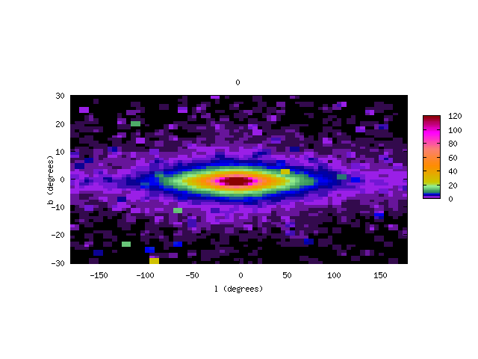
Our view in the galaxy
warping as well as sloshing

Slide 28
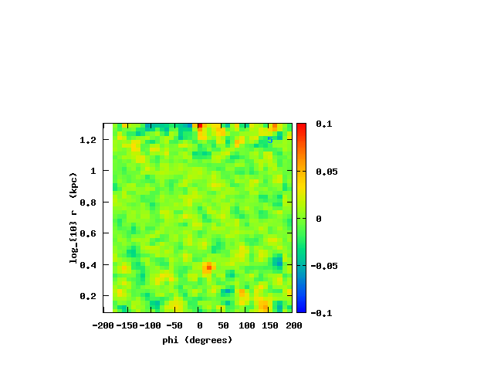
Star formation with multiple patterns
In a frame corotating with a position outside the bar
Star formation is not continuous
Armlets appear and disappear causing localized bursts of star formation
Most bursts move from inner to outer radius, opposite to what may is seen in the solar neighborhood cluster distribution within 200 pc of the Sun (Mamajec)
Despite localized density peaks the galaxy still looks like a spiral galaxy

Slide 29
 | Coupled and multiple density waves | Transient spirals
Heating and radial migration | Chaotic diffusion. Wave coupling implies resonance overlap (e.g., Shevchenko, Minchev). Heating/Migration rate strongly is dependent on position in galaxy and likely to be maximum when and where both bar and spirals are present. As a bar slows down, resonances can be swept through the disk. | Heating via appearance and disappearance of spiral arms. Migration associated with corotation resonance. No prescription for prediction differences in migration/heating rates with position or time.
Star formation | Short local bursts can occur where there is constructive interference between waves | Continuous star formation predicted as single waves pass through the disk.
Implication: It should be possible to differentiate between these scenarios

Slide 30
Caveats
One simulation – based on GALACTICS initial conditions for Milky Way model, but lacking gas
Undersampled halo, heating of disk by halo but at level expected from molecular clouds
Poor force resolution, this is a noisy but rich simulation
Growth of lopsided mode could be due to poor energy conservation
Increasing numbers of particles and using smaller timesteps may give an unrealistic galaxy --- if a quieter and more accurate simulation fails to grow a lopsided mode and our galaxy has one (it is lopsided) then outside perturbations are needed to seed it. Particularly important if three armed waves are due to bar/lopsided coupling

Slide 31
Final Comments on galactic disk
Structure in velocity distribution expected all over the galaxy
Gaps in velocity distribution related to
  changes in dominant wave
  Lindblad resonances as spiral waves beginning and end at them and are coupled
  discontinuities in arms
More work needed to
  figure out patterns speeds, strengths and offsets from velocity distributions
  Match up structure in galaxy to models (including armlets) – possibly waves at all radii are coupled
  Relate radial migration and heating to waves present in simulation
  look at better and more simulations (shorter bar, more particles yet want spiral structure)
  understand the non-linear mode coupling

Slide 32
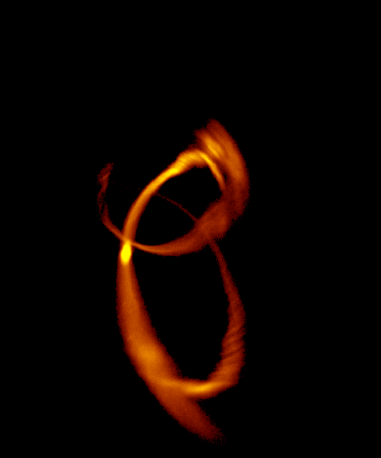
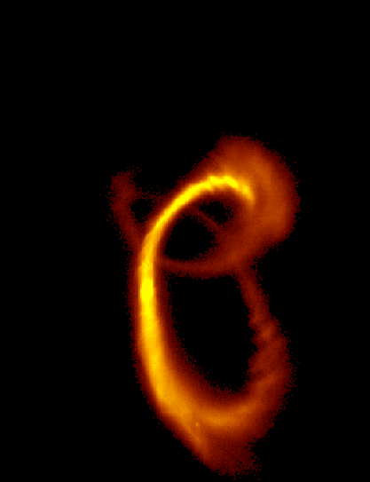
Examples
Structure of Self-Gravitating Stellar Tidal tails
Substructure in tails is resolved with a few million particles in disrupting dwarf
Substructure depends on number of dark matter halo particles?
10⁴ halo particles 10⁵ halo particles
Structure of tidal tails
Comparetta & Quillen (2010)

Slide 33
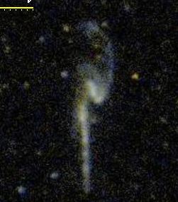
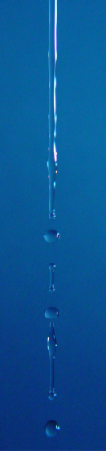
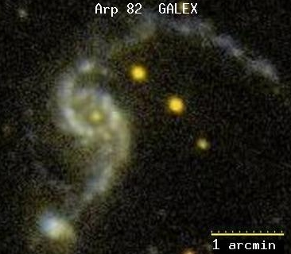

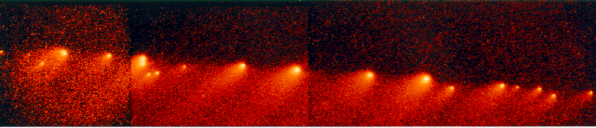
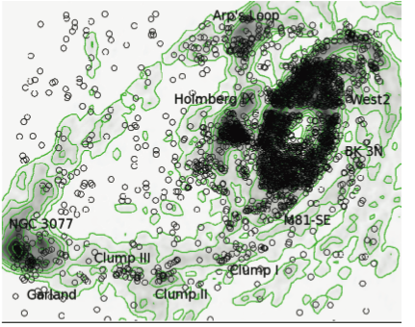
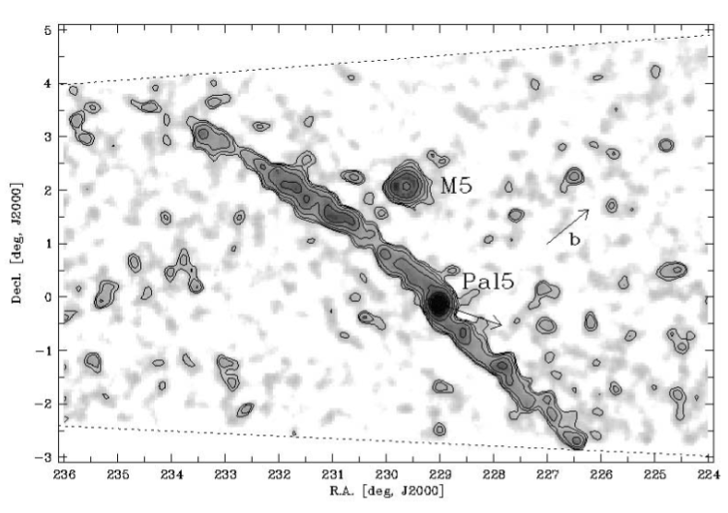
ARP 242 GALEX
Smith et al. 2010
Comet Shoemaker-Levy 9
SDSS counts Palomar 5 Odenkirchen et al. 02

Slide 34
Jeans Instability
For gas:
  Gravity pulls clumps together
  Pressure prevents collapse
  Magnetic pressure prevents varicose collapse of a gas cylinder (Chandrasekhar & Fermi 1953) Longitudinal collapse still possible (e.g., Ostriker ‘64)
For stars:
  Gravity pulls together
  Random motions prevent collapse at small wavelengths -- Landau damping in a plasma (Fridman & Polyachenko)
gravity
pressure

Slide 35
Jeans Instability of a stellar Cylinder
Growth rate depends on the wavelength,
  for plane waves larger wavelength perturbations grow more quickly
Wavelengths larger than the cylinder diameter don’t feel gravity as strongly
→ There is a fastest growing wavelength – as there was for the Plateau-Rayleigh instability

Slide 36

Longitudinal Perturbations of a Stellar Cylinder
σ* velocity dispersion or sound speed
μ linear mass density
G gravitational constant
r₀ cylinder radius
f(z,v) = f₀ + f₁ distribution function (see Fridman and Polyachenko)
Linearized version of the collisionless Boltzmann equation
Perturbations on a cylinder proportional to cos kz produce gravitational perturbations of the form
and a very approximate dispersion relation

Slide 37
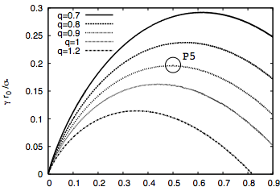

Wavelengths and Growth rates of the fastest growing wavelength
For wavelengths sufficiently long there is instability
Instability cuts off at short wavelengths due to Landau damping
With motions restricted to along tail, only one parameter determines fastest growing wavelength
growth rate
large λ
unstable
small λ
damped
k r_{o} →
For q~1 fastest growing wavelength has λ~few times r₀ and growth rate ~ σ/r₀
Estimate is not accurate as it is difficult to calculate for kr₀~1 near the fastest growing wavelength
To first order, sausage and longitudinal variations have same dispersion relation

Slide 38
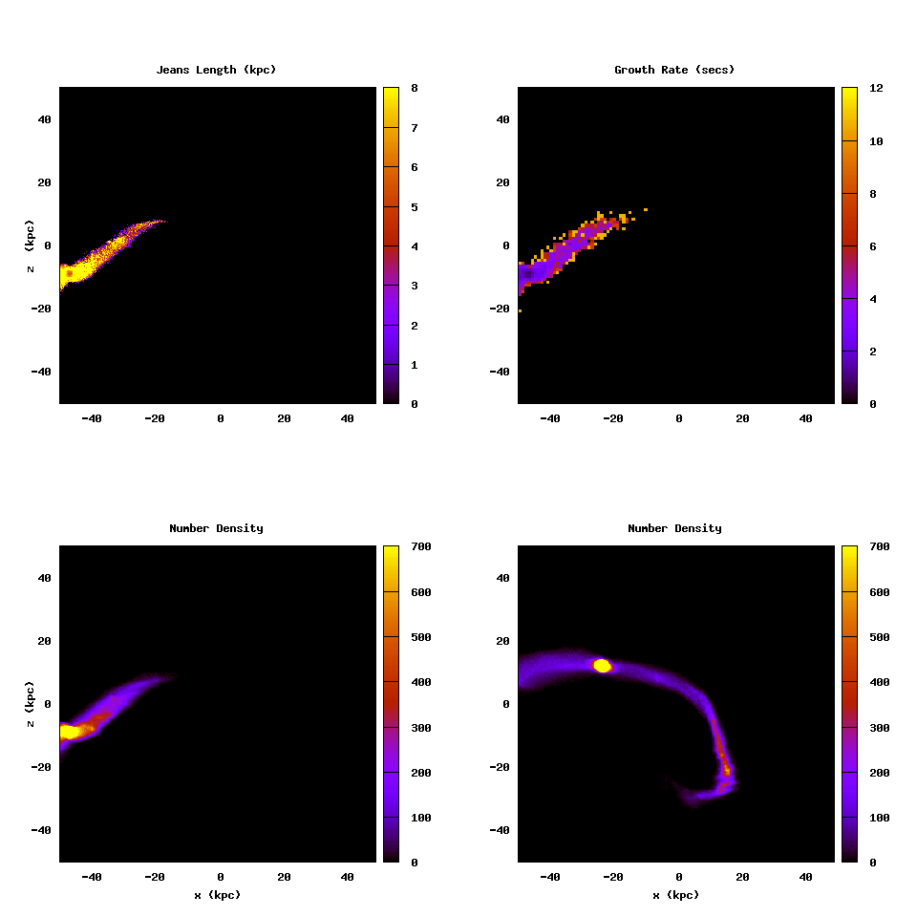
Jeans length
Growth rate
Number density after t= growth rate
Number density

Slide 39
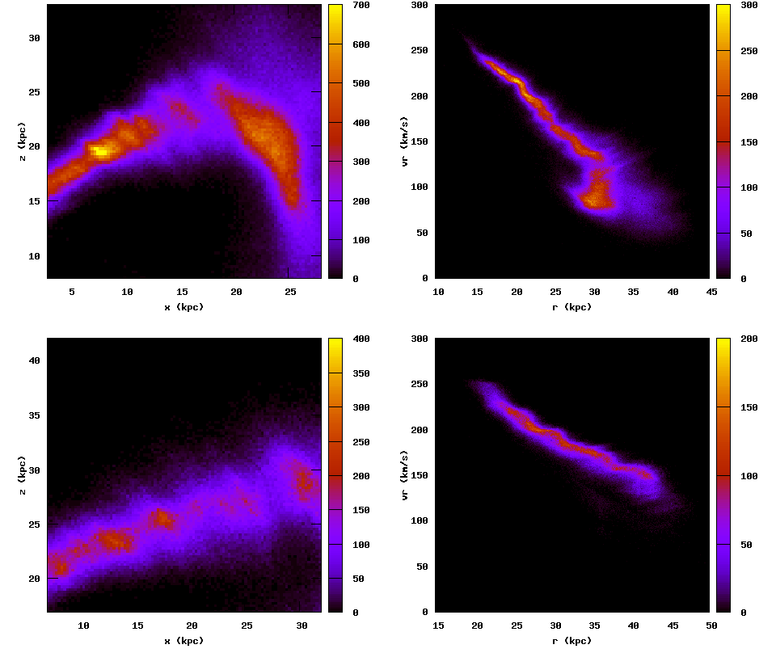
Real space
Velocity space
z (kpc)
radial velocity (km/s)
x (kpc)
r (kpc)
z (kpc)
Compressive motions
x (kpc)

Slide 40
Comments on Jeans Instability
All tidal tails and filaments are unstable to clumping via Jeans Instability. However the growth timescale and wavelength could be long enough that for all practical purposes clumps will not form
There is a fastest growing wavelength. Calculating its properties is non-trivial as it lies in the regime k r₀~1
Instability itself may have heated the tail. At first we thought this would allow better estimates of tail density and dispersion but now think that constraints on past properties of the tail are more likely.
Clumping has not been found in some systems (e.g., Sag dwarf tidal tails). Does that mean not there or just not found?

Slide 41
Tests of CDM
CMD predicts many subhalos; over production of Dwarf galaxies problem.
Observational Constraints on subhalos:
  lensing of distant objects -- so far no strong constraints; (Zackrisson & Riehm 2010) but perhaps promising future
  gamma rays from dark matter (enhanced by large phase space density in subhalos)
  tidal tails?

Slide 42
Dark matter Sub-halos causing structure in tidal tails
Heating of Palomar 5 tail: (Johnston, Spergel, Haydn 2002, Ibata et al. 2002)
Clumping in dwarf tails: (Siegal-Gaskins and Valluri 2008)
Kinks or folding of Palomar 5 like tail (Carlberg 2009)
Seeding of Jeans instability, followed by heating which changes the wavelength of maximum growth rate? (us)

Slide 43
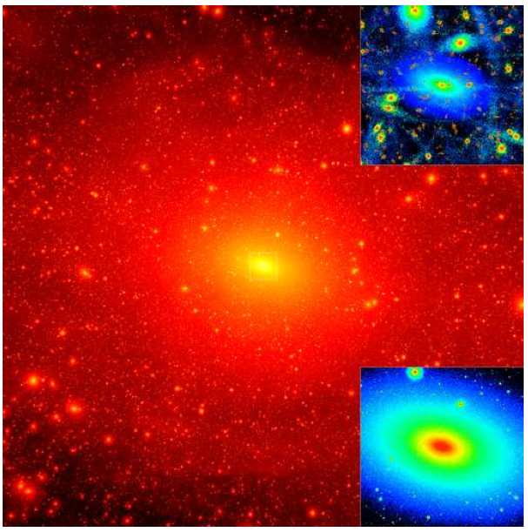
Testing CDM with tidal tails?
via Lactae II, Diemond et al 2008
~10% of halo is in subhalos
~ 10⁹ M/ kpc in subhalos
dN/dM ~ M⁻² for subhalos
a few subhalos of 10⁷ M with v_{max} ~3 km/s will lie within Sagittarius dwarf stream or with 1 kpc of Pal 5’s stream.
a halo of 10⁸ Mwill pass through a Sag tail or within 1 kpc of a Pal 5 tail in one orbital period (order Gyr) with v_{max} ~10 km/s
our halo particles are too many and too big (a challenge for better simulations)
Perturbations of order a km/s expected from sub-halos

Slide 44
Summary
Approach: simulated as many particles as we could in tidal tails and galactic disk. Tracer particles used to show structure without sacrificing self-consistency
Interesting sub-structure predicted: could be revealed by future surveys of ~ a billion stars.
Potential CDM test possible with tidal tails?
Coupled wave view of spiral structure may have interesting consequences for mapping the Milky Way and understanding migration and heating of disk

